Slide 1
Rhode Island Health Care Cost Trends: Trends in Health Care Cost Growth Pre-COVID-19, Experience with Care Delivery During COVID-19, and How to Address Pharmacy Costs
October 23, 2020

Slide 2
Cost Growth Target Baseline Performance
Results of analysis of 2017-2018 data
October 23, 2020

Slide 3
Background
In December 2018 the Cost Trends Steering Committee established an annual cost growth target of 3.2% per capita for 2019-2022. Data to evaluate the first year of performance were recently gathered from public and private payers and will be reported in a few months.
In order to calculate the per capita cost trend for the year preceding the cost growth target, OHIC requested that the state’s four largest insurers submit total medical expense data in October 2019 for calendar years 2017 and 2018. Data were also gathered from Medicare, and from Medicaid for non-MCO expenditures.
Payers were asked to follow the specifications outlined in the July 31, 2019 Cost Trends Implementation Manual when preparing their submissions.

Slide 4
Validation of Baseline Performance Data
Project staff performed a two-part validation process on insurer-submitted data.
Completeness check
Reasonableness check using publicly available benchmarks and other data
Following the initial validation process, project staff worked with insurers to improve their data submissions.
Project staff also calculated the Net Cost of Private Health Insurance (NCPHI) using publicly available data sources.
NCPHI represents insurer administrative expense plus margin.
Finally, staff at Gorman Actuarial provided a peer review of the results.

Slide 5
Baseline Performance: Notes of Caution
The baseline performance results cannot be compared to analysis of All-Payer Claims Database (APCD) data. Insurer-submitted data includes the following, which are not found in APCD data:
Non-claims payments
The entire self-insured population
Pharmacy rebates
The baseline performance results cannot be compared to other publicly available measurements of health spending for similar reasons.
Payer data submissions were validated, but not audited. We cannot be certain that each payer performed the calculations correctly. Project staff have been sharing with each insurer its own specific data relative to overall trends by market as one final review.

Slide 6
Using Different Data Sources to Inform Understanding
Payer-Reported aggregate Data
APCD Analyzed data
Primary purpose: assess performance against the cost growth target
Payer-reported data are provided in aggregate and are limited in detail, but do represent all health care spending in the state (including spending in self-insured employer benefit programs).
Primary purpose: identify underlying cost and cost growth drivers
APCD data are more detailed than payer-reported aggregate data. Claims-level analyses can be performed. While not all state spending data are included, there are more than enough to understand underlying trends.
How much did spending increase or decrease from one year to the next?
What is driving overall cost and cost trends? Where are opportunities?

Slide 7
Key Definitions:
Total Medical Expense (TME): The medical expenses incurred by Rhode Island residents for all health care services by all payers reporting cost growth data to OHIC. TME is reported net of pharmacy rebates.
Net Cost of Private Health Insurance (NCHPI): Measures the cost to Rhode Island residents associated with the administration of private health insurance (including Medicare Advantage and Medicaid managed care). It is defined as the difference between health premiums earned and claims paid, and consists of insurers’ cost of paying bills, advertising, sales commissions and other administrative costs, premium taxes and profits (or contributions to reserves) or losses.
Total Health Care Expenditures (THCE): TME plus NCPHI. THCE is reported net of pharmacy rebates.

Slide 8
State Total Health Care Expenditures
Aggregate Annual Trend
Per Capita Annual Trend
NCPHI
Commercial
Medicaid
Medicare
14.9%
1.9%
5.8%
4.4%
3.6%
2017
2018
2017
2018
Total Spending:
Per Capita Spending:
$7.40B
$7.73B
$7,001
$7,309
These values are not risk-adjusted and are net of rebates.
Medicare FFS values are gross of rebates, as the State did not receive rebate information from CMS. This slightly overstates Medicare spending.

Slide 9
Total Medical Expense by Market
Aggregate Annual Trend
Per Capita Annual Trend
Trend: 3.4%
Trend: 5.8%
2017
2018
2017
2018
2017
2018
These values are not risk-adjusted and are net of rebates.
Medicare FFS values are gross of rebates, as the State did not receive rebate information from CMS. This slightly overstates Medicare spending.

Slide 10
Service Category Trends – State
Category | Trend
Non-claims | 6.5%
Other Claims | 2.7%
Other Professional | 6.2%
Long-Term Care | -1.2%
Professional Physician | 2.9%
Hospital Outpatient | 7.2%
Retail Pharmacy (Net of Rebates) | 9.8%
Hospital Inpatient | -0.9%

Slide 11
Category | 2017-2018 Trend
Hospital Outpatient | 5%
Retail Pharmacy (Net of Rebates) | 2%
Hospital Inpatient | -2%
Professional Physician – Primary Care | -3%
Professional Physician – Specialty Care | 7%
Other Professional | 5%
Other Claims | -2%
Non-Claims | 3%
Long-Term Care | -11%
2017
2018
These values are not risk-adjusted.

Slide 12
Category | 2017-2018 Trend
Hospital Inpatient | -3%
Retail Pharmacy (Net of Rebates) | 12%
Professional Physician | 2%
Hospital Outpatient | 11%
Long-Term Care | -3%
Other Claims | 4%
Other Professional | 4%
Non-Claims | 23%
2017
2018
These values are not risk-adjusted. Also, pharmacy rebates are included only for the MCO portion of Medicare spending and not for Medicare FFS. Long-term care spending was defined to include SNF. SNF will be redefined in a different category in future years.
CMS did not report specialty physician spending; therefore, all physician spending is categorized together.
Spending for NHPRI’s Integrity product is excluded from service category spending due to an inability to estimate what proportion of service category spending is Medicaid and Medicare.
.

Slide 13
Category | 2017-2018 Trend
Long-Term Care | 8%
Hospital Inpatient | 2%
Hospital Outpatient | 4%
Other Professional | 10%
Other Claims | 1%
Retail Pharmacy (Net of Rebates) | 23%
Non-Claims | 4%
Professional Physician - Specialty Care | 2%
Professional Physician - Primary Care | 5%
2017
2018
These values are not risk-adjusted.
Spending for NHPRI’s Integrity product is excluded from service category spending due to an inability to estimate what proportion of service category spending is Medicaid and Medicare.

Slide 14
Service Category Trends – Hospital Care
Spending on outpatient hospital services was the fastest growing category of spending.
Care has been shifted from inpatient to outpatient, consistent with national trends.
Medicare was the primary driver of the overall statewide trend in hospital outpatient spending.
MCO (15%)
FFS (9%)
These values are not risk-adjusted.
Spending for NHPRI’s Integrity product is excluded from service category spending due to an inability to estimate what proportions of service category spending are Medicaid and Medicare.
% of Total Spending by Service Category
 | Commercial | Medicaid | Medicare
Inpatient | 19% | 15% | 25%
Outpatient | 25% | 14% | 15%
(increase in hospital outpatient spending)

Slide 15
THCE Trends – Net Cost of Private Health Insurance
4%
Medicare MCO plans have the highest admin and margin per member per year.
Greatest overall increases in NCPHI were from the commercial individual and small group markets.
The trend in the individual market was very high, but enrollment was low.
15%
25%
Weighted average based on member months reported by insurers.
PMPY NCPHI Trend by Market Segment
Medicaid MCO | Medicare MCO | Self-Insured | Large Group | Small Group | Individual
4% | 15% | -1% | 13% | 35% | 169%

Slide 16
Commercial Market Enrollment
Category | Trend
Self-Insured | -2%
Large Group | -2%
Small Group | -3%
Individual | 4%
2017
2018
Data are presented in member months and represent Rhode Island residents only

Slide 17
Brown Analyses: Drug Costs
October 23, 2020

Slide 18
Agenda
Drug Costs: Retail Pharmacy and Medical Pharmacy Costs
Pharmaceutical Costs as Drivers of Total Cost
Pharmaceutical Costs as Drivers of Cost Trends
Utilization vs Price
Retail Pharmacy Costs: Deeper Dive
Medical Pharmacy Costs: Deeper Dive
Conclusions

Slide 19
Retail and Medical Pharmacy Costs

Slide 20
Pharmacy Costs
“Retail Pharmacy” costs or spend: refers to prescription medicines purchased in retail pharmacies
“Medical pharmacy” costs or spend: refers to prescriptions administered in providers’ offices and hospitals
Less appreciated by many as a part of the overall drug spend
Appears in claims files as part of “Professional Services”
Identified by “J Codes”
Growing rapidly

Slide 21
Drivers of Total Cost

Slide 22
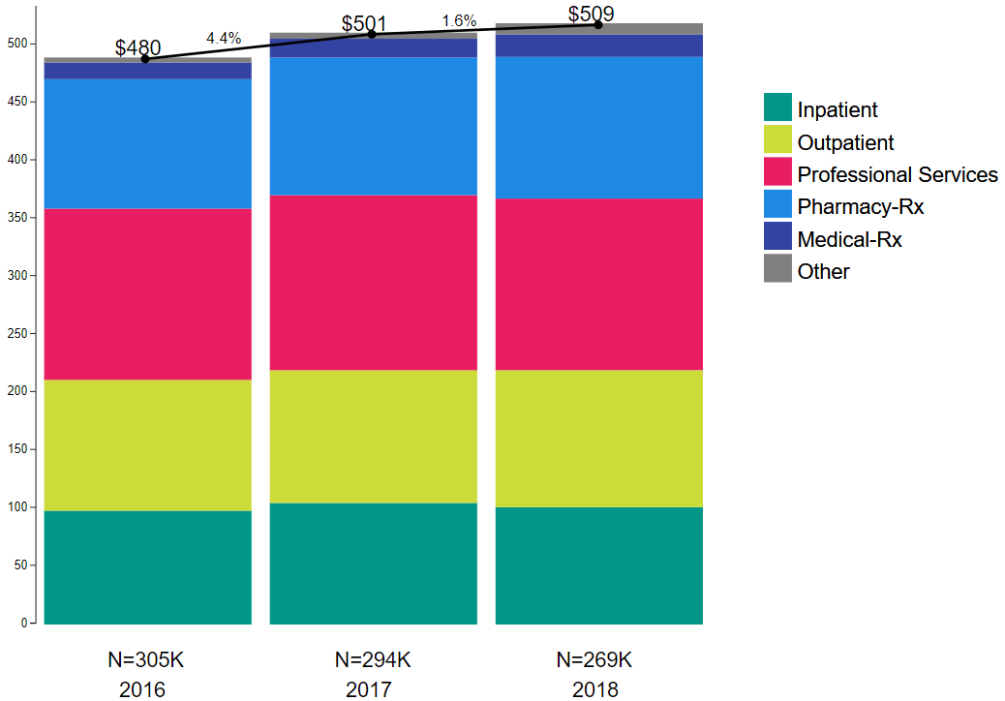
Total PMPM:
Commercial Insurance
Note: these numbers are similar – but not identical – to the aggregate numbers you saw presented earlier.

Slide 23
% PMPM: Commercial Insurance
Retail Pharmacy + Medical Pharmacy = significant and growing fraction of total PMPM

Slide 24
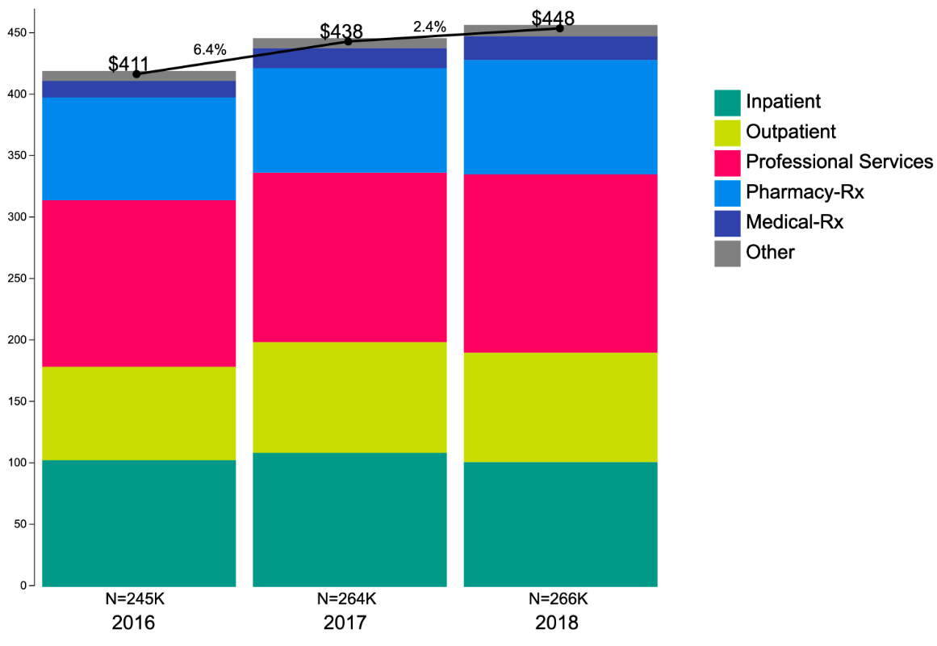
Total PMPM:
Medicaid MCO
Note: these numbers are similar – but not identical – to the aggregate numbers you saw presented earlier.

Slide 25
% PMPM: Medicaid MCO
Retail Pharmacy + Medical Pharmacy = significant and growing fraction of total PMPM

Slide 26
Drivers of Total Cost Trend

Slide 27
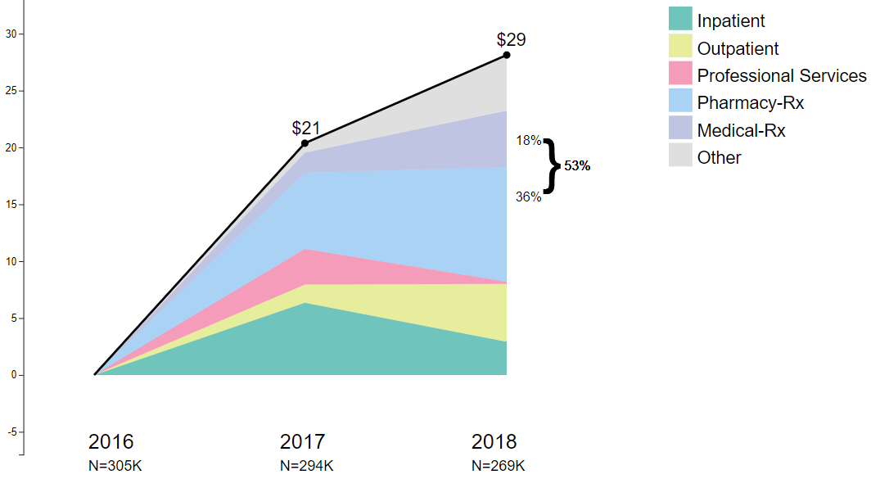
Cumulative Change in PMPM ($) since 2016
Drivers of Trend:
Commercial Insurance
53% of cost increase = retail & medical pharmacy

Slide 28
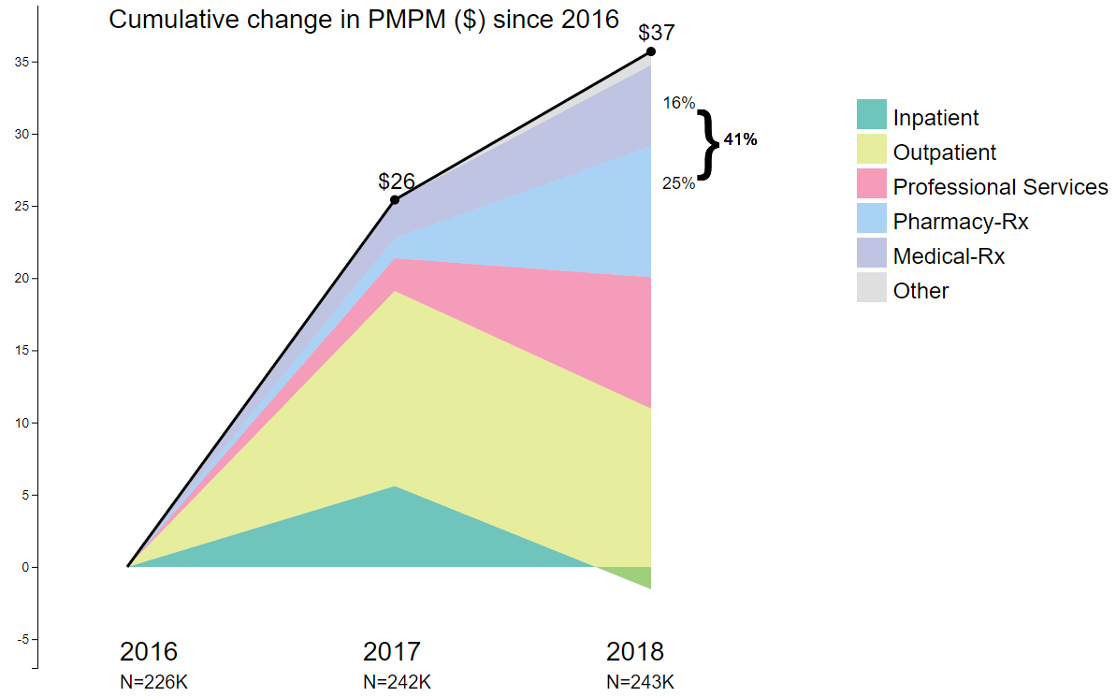
Cumulative Change in PMPM ($) since 2016
Drivers of Trend:
Medicaid MCO
41% of cost increase = retail & medical pharmacy

Slide 29
Utilization vs. Price

Slide 30
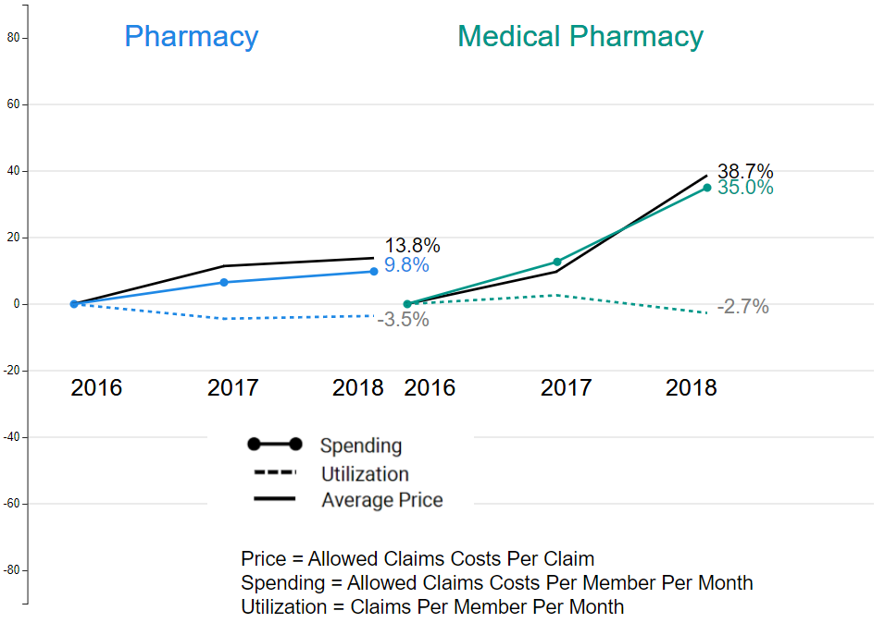
Commercial: Utilization vs. Price

Slide 31
Commercial: Utilization vs. Price
Cost increases driven by price, particularly in medical pharmacy, where utilization actually trended downward 2017-18

Slide 32
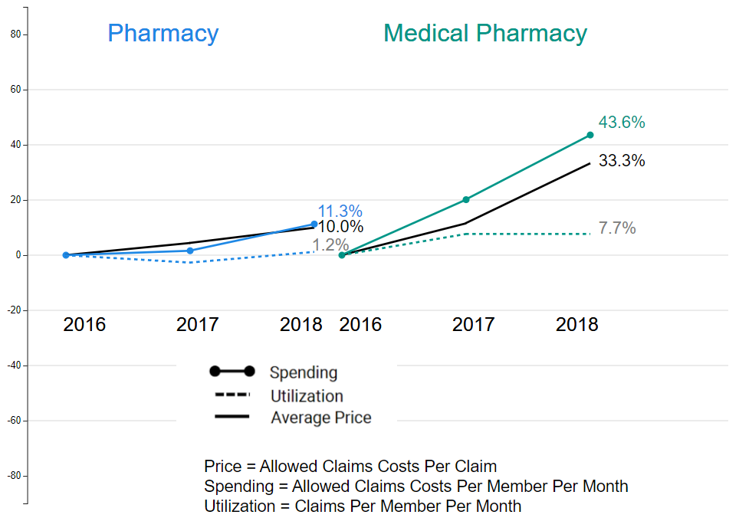
Medicaid MCO: Utilization vs. Price

Slide 33
Medicaid MCO: Utilization vs. Price
Cost increases driven mostly by price, particularly in medical pharmacy

Slide 34
Retail Pharmacy Costs: Deeper Dive

Slide 35
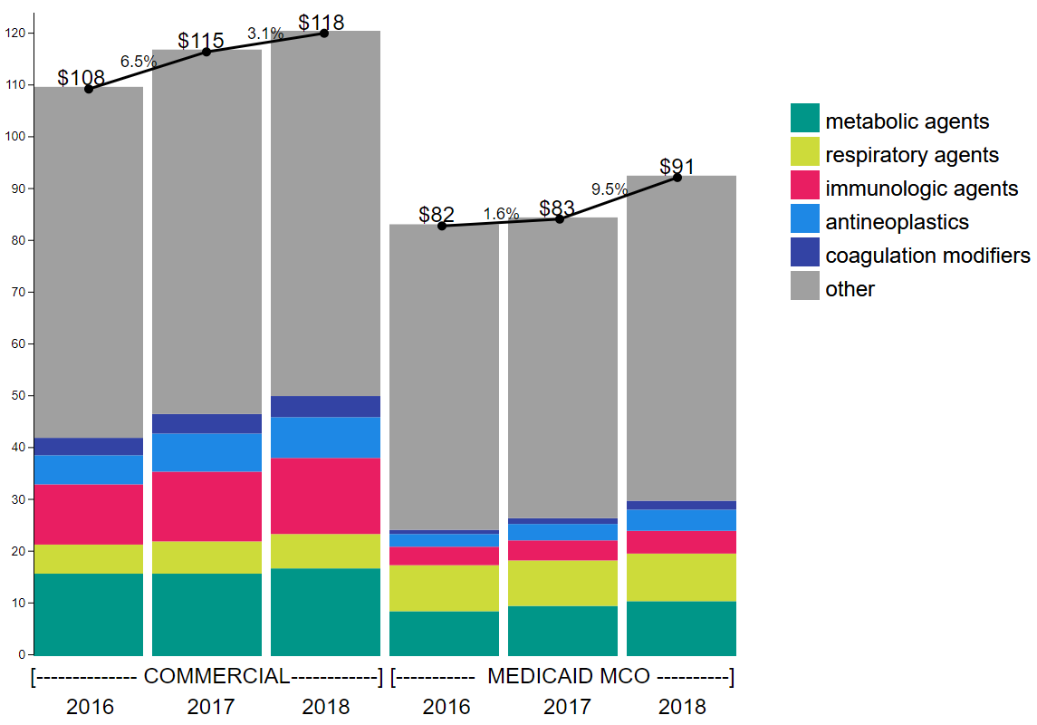
Total Cost, Top 5 Drug Classes in color (of 18 classes)

Slide 36
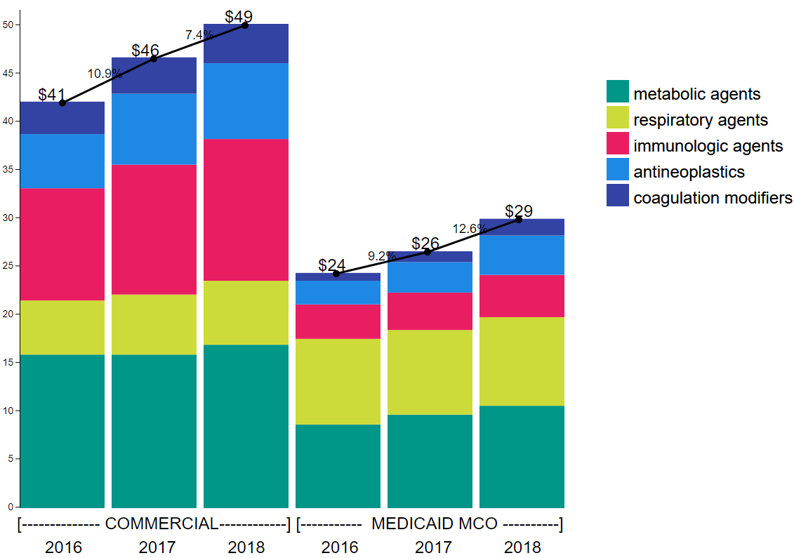
Total Cost: Top 5 Drug Classes

Slide 37
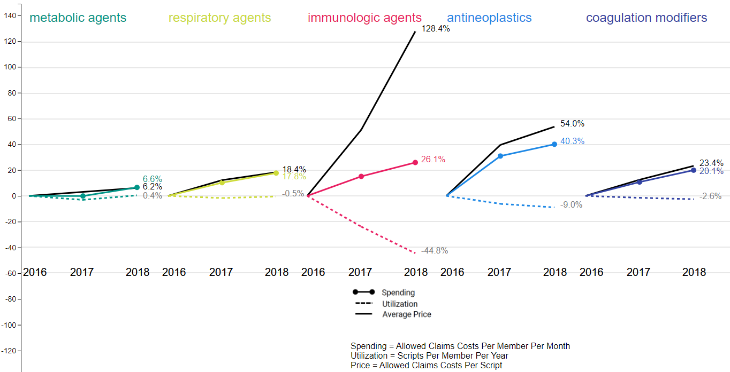
Commercial Top 5 Classes: Utilization vs. Price
Price increases are dramatic

Slide 38
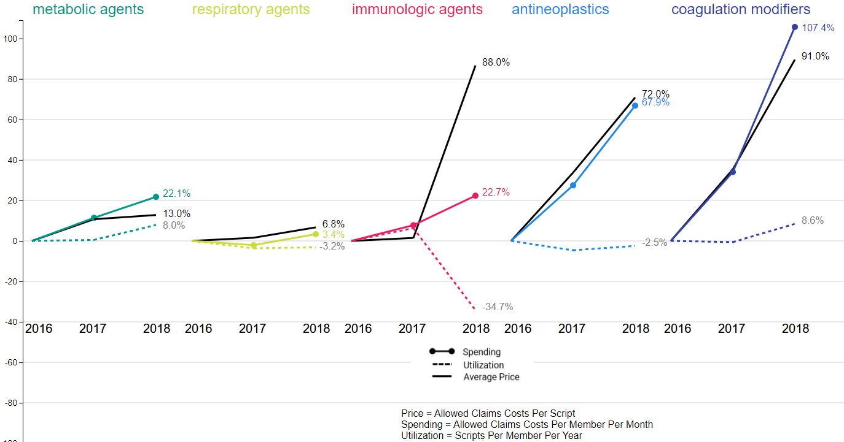
Medicaid MCO Top 5 Classes: Utilization vs. Price
Price increases are dramatic

Slide 39
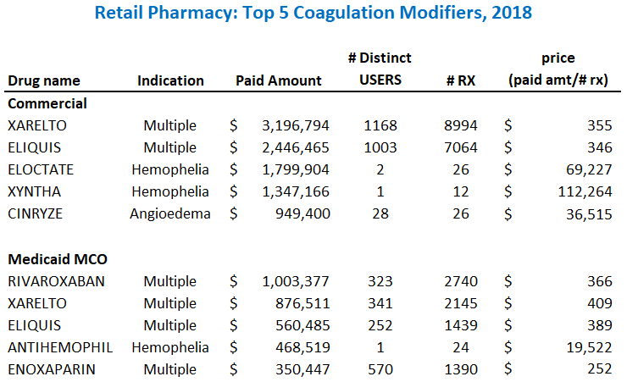

Slide 40
Some drugs are moderately expensive per dose, but used by relatively large numbers of patients

Slide 41
Other drugs are extremely expensive and used by very few patients

Slide 42
Medical Pharmacy: Deeper Dive

Slide 43
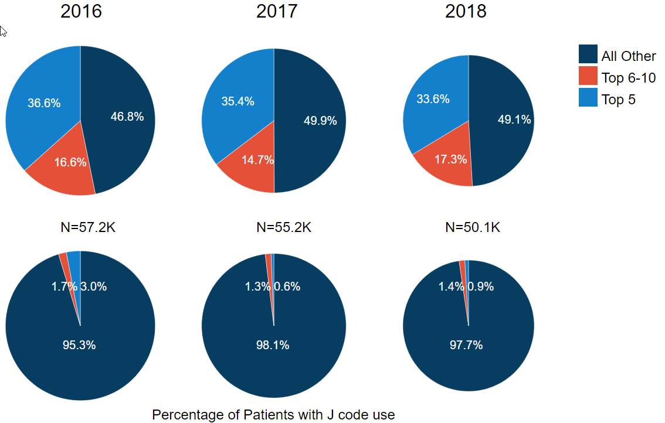
Commercial
% of Medical Pharmacy Spend: Top 10 Medications
More than half of the spending is on the top 10 drugs

Slide 44
Commercial
% of Medical Pharmacy Spend: Top 10 Medications
Small % of beneficiaries use these top 10 medications

Slide 45
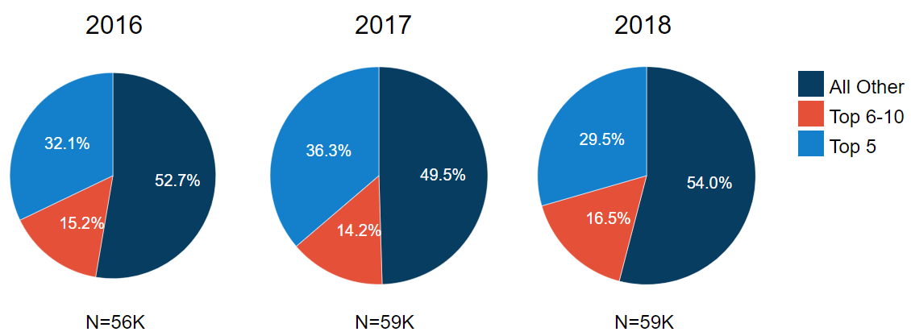
Medicaid MCO
% of Medical Pharmacy Spend: Top 10 Medications
Just less than half of the spending is on the top 10 drugs

Slide 46
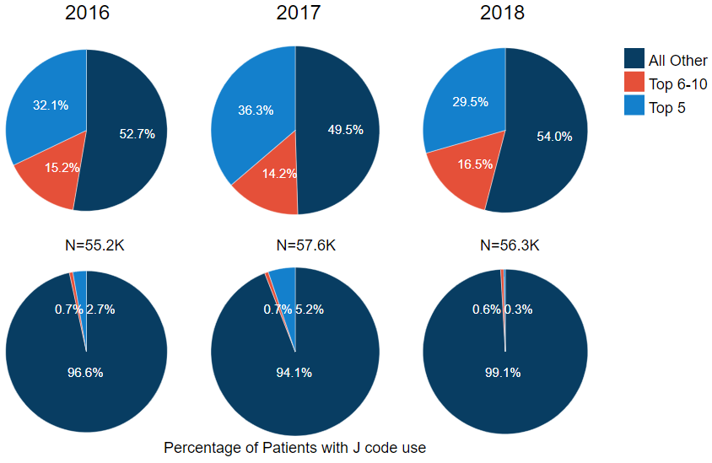
Medicaid MCO
% of Medical Pharmacy Spend: Top 10 Medications
Small % of beneficiaries use these top 10 medications

Slide 47
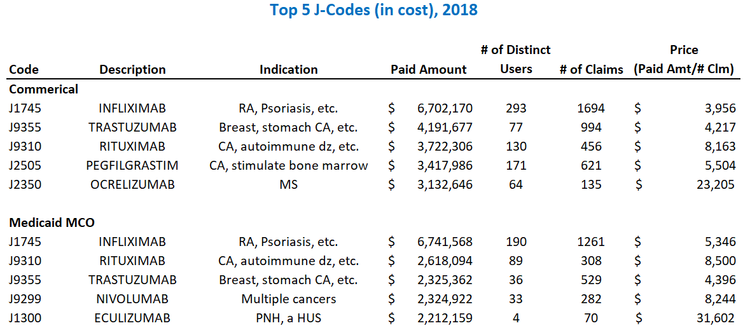

Slide 48
Medical Pharmacy
Dramatic price increases
Large portion of medical pharmacy spend is on a small number of very expensive drugs used by a few beneficiaries

Slide 49
Conclusions

Slide 50
Data Considerations
Commercial data does not include claims from self-insured employers who elected not to submit, and claims from BCBS MA
Total cost data excludes non-claims-based payments
Data excludes manufacturer rebates, which vary in magnitude from 10% to 20% of total pharmacy costs
If we adjusted for rebates, it would reduce the costs that we show

Slide 51
Conclusions
Pharmaceutical costs are an important contributor to both costs and trends in costs
Medical pharmacy is an important component of total pharmacy costs and should be monitored closely
Price, not utilization, is what is driving cost increases
Interventions to control pharmaceutical prices are needed

Slide 52
Extra Slides

Slide 53
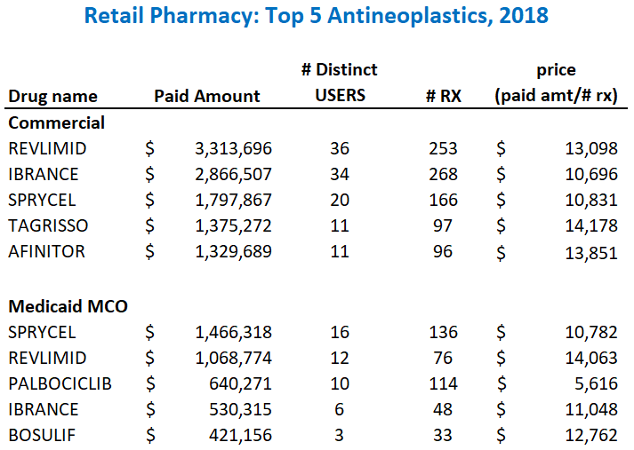

Slide 54
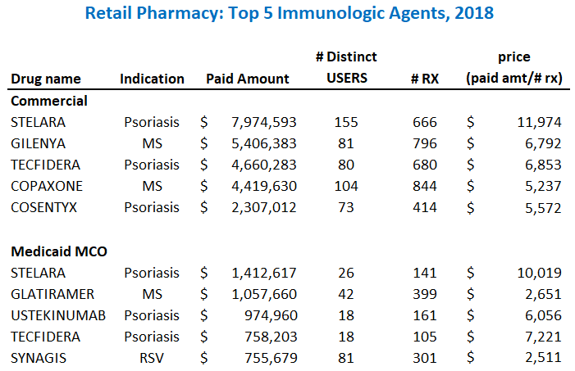

Slide 55
Rhode Island Health Care Cost Trends Project How to Address Pharmacy Costs October 23, 2020
Trish Riley -Executive Director
National Academy for State Health Policy
triley@nashp.org

Slide 56
Setting the Stage: State Action
Drug Pricing Laws 2017-2020
Year | 2017 | 2018 | 2019 | 2020 | Total
Number of States Enacting Laws | 13 | 28 | 37 | 17 | 48
Total Laws Enacted | 18 | 45 | 62 | 35* | 160*
PBM | 8 | 32 | 33 | 19 | 92
Transparency | 3 | 4 | 7 | 4 | 18
Importation | 0 | 1 | 3 | 2 | 6
Affordability Review** | 1 | 0 | 3 | 1 | 5
Volume Purchasing | 0 | 0 | 2 | 0 | 2
Coupons/Cost Sharing | 1 | 0 | 4 | 9 | 14
Study | 0 | 1 | 5 | 1 | 7
Other | 5 | 7 | 5 | 0 | 17
Since 2017, legislation to address prescription drug costs has been introduced in all 50 states.
Since 2017, 48 states have enacted 160 laws to address prescription drug costs.
*Totals laws enacted are lower than column totals because a New Hampshire law contains multiple provisions.
** Includes New York’s Medicaid drug cap and Massachusetts’ enhanced negotiating authority.
2

Slide 57
Legal Issues Addressed
Patent Preemption
Vagueness
Dormant Commerce Clause
State price controls on patented drugs interfere with the federal patent scheme
Laws must define prohibited conduct well enough for companies to know what's illegal
States can't regulate prices charged in out-of-state transactions
*
3

Slide 58
Unsupported Price Increases
Background:
The Institute for Clinical and Economic Review (ICER) produces an annual report identifying the drugs with unsupported price increases outpacing 2x medical inflation that are the greatest drivers of net spending
Unsupported price increases = unjustified by new clinical data
What:
State tax authority is used to assess penalties on manufacturers identified in annual ICER report as having a drug with an unsupported price increase
Penalties = 80% of excess revenues (i.e., revenue from unsupported portion of price increase)
Manufacturers must report information on total sales revenue in the state to the Tax Assessor to determine the penalty owed
Impact: Because ICER’s analysis targets drugs with the greatest impact on net spending, penalties can result in millions in revenue for a state -- revenue that the Model Act specifies must be used to offset costs to consumers
4

Slide 59
2019 Results
 | Q42016 to Q42018 Wholesale Acquisition Cost (WAC) Increase | Q42016 to Q42018 Estimated Average Net Price Increase | US Spending Impact of Net Price Increases in 2017 and 2018 (in Millions)
Humira | 19.1% | 15.9% | $1,857
Lyrica | 28.3% | 22.2% | $688
Truvada | 14.3% | 23.1% | $550
Rituxan | 17.0% | 13.8% | $549
Neulasta | 14.6% | 13.4% | $489
Cialis | 26.2% | 32.5% | $403
Tecfidera | 16.7% | 9.8% | $313
5

Slide 60
Legal Issues Addressed
Patent Preemption
Vagueness
Dormant Commerce Clause
State price controls on patented drugs interfere with the federal patent scheme
Laws must define prohibited conduct well enough for companies to know what's illegal
States can't regulate prices charged in out-of-state transactions
6

Slide 61
International Reference Rates
Why:
Foreign countries pay a fraction of what Americans pay for prescription drugs
Rate setting is a common approach in the health care sector – one that can be extended to setting rates for prescription drugs
International prices offer a fair, easy-to-implement approach to rate setting
What:
Develop a list of the 250 drugs costing the state the most
The state references Canadian prices
The lowest price becomes the international reference rate for payers in the state
Impact: This model act can greatly lower prescription drug spending in a state - without running afoul of patent law through price setting.
7

Slide 62
How Would It Work?
State Dept of Insurance with Board of Pharmacy
State Employee Health Plan identifies 250 costliest drugs
DoI with Board determines Canadian prices and sets as Upper Payment Limit
Payers cannot pay more than that limit for drug
ERISA: Self-funded plans may participate voluntarily
Medicaid – exempt at first/federal rules/waivers needed
Protects local pharmacies
8

Slide 63
Why Canada?
Publicly available data
Analyzes data from a basket of OECD countries to set price
Model uses price data from 4 provinces ( Ontario, Quebec, BC, Alberta) and, for unavailable prices, Patented Medicines Prices Review Board
Uses lowest of these or US price to set upper limit
Could reference price to US Medicare if most favored nation implemented
9

Slide 64
Example Drug Price Comparisons
Drug | US Price (NADAC) | Canadian Reference Rate | How much more US consumers pay vs. Canadians
Xeljanz [5 mg] (rheumatoid arthritis) | $76.07 | $16.96 | 448.53%
Eliquis [2.5 mg] (Anticoagulant) | $7.53 | $1.17 | 643.59%
Eplcusa [400/100 mg] (hepatitis C) | $869.05 | $521.43 | 166.67%
Zytiga [250 mg] (cancer) | $87.63 | $20.68 | 423.74%
* Prices, effective as of June 2020, represent unit cost (i.e., per tablet, pill, etc.) in US dollars, converted at an exchange rate of $1 CAN = 73 cents USD.
10

Slide 65
Legal issues
Patent Pre-emption
Biotechnology Industry Organization v. D.C. – ruled a DC law prevented Rx from being sold at excessive price
Court ruled law limits patent protection on manufacturer pricing
This model:
Does not limit to patented products
Does not regulate price
-Dormant Commerce Clause
This model : strictly limits to in–state transactions ; protects local pharmacies
11

Slide 66
NASHP Rx Pricing Center Can Help
Model laws, Q and A, legal briefs
Convene with other states advancing these models – “safe harbor”
Staff technical assistance
And whatever else you need…..
https://www.nashp.org/policy/prescription-drug-pricing/
Special thanks to Arnold Ventures for on-going support
12

