Slide 1
The RESET Opportunity in Rhode Island
Partnering & Collaborating to Reduce Low Value Care
December 2, 2019
Michael Thompson
National Alliance
Mthompson@nationalalliancehealth.org
Daniel Wolfson
ABIM Foundation
dwolfson@abim.org
Al Charbonneau
RI Business Group on Health
alcharbonneau@Verizon.net

Slide 2
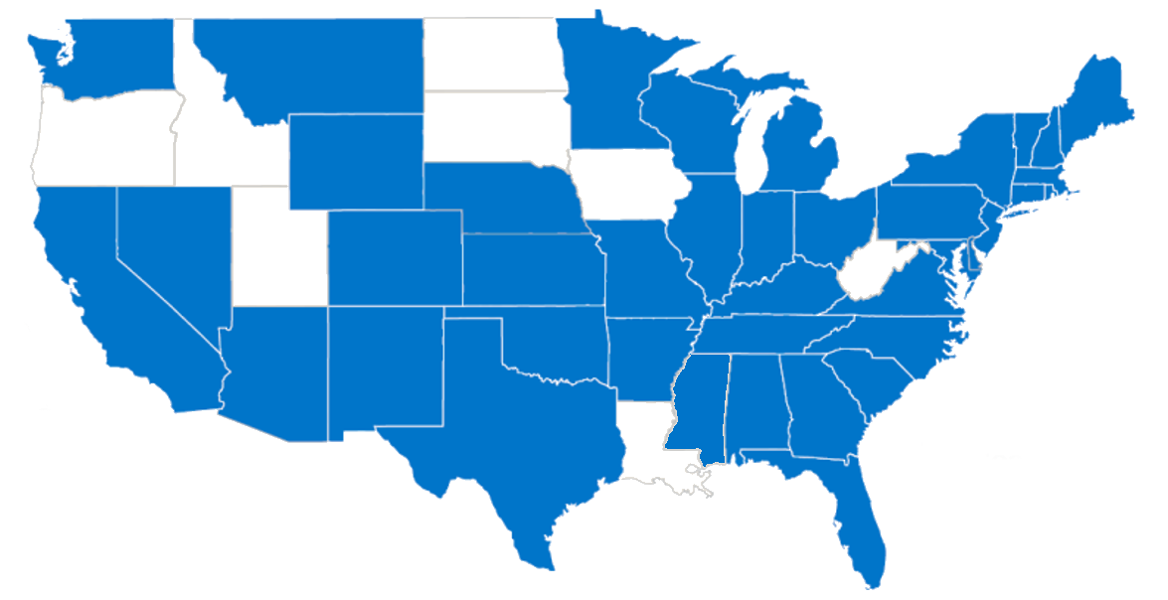
What is the National Alliance?
The only nonprofit, purchaser-led organization with a national and regional structure dedicated to driving health and healthcare value across the country
More than 12,000 employers/purchasers and 45 million Americans, spending $300 billion annually on healthcare
Cross-section of Private Sector including 60% Fortune 100
Public Sector including states, cities, school districts and the federal government
Union organizations (eg UAW, UAW Trust, 32 BJ)
2019 Coalition Membership Map

Slide 3
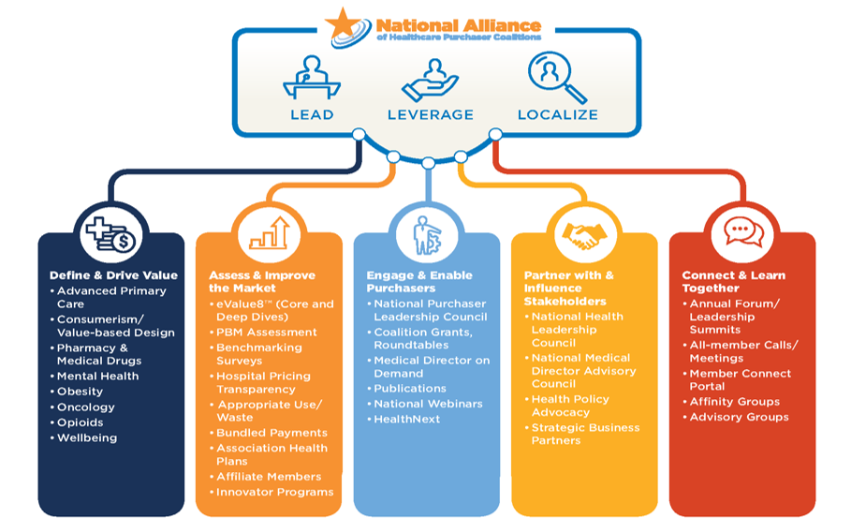
Our Approach
Notes:
Asked Jean to provide an update and some screen shots from our website changes

Slide 4
National Coordinating Choosing Wisely Initiative Office
Collaborative Learning * Measurement * Team-based care * Patient/community engagement
National Steering Committee
ABIM Foundation
AcademyHealth
National Alliance of Healthcare Purchaser Coalitions
National Technical Resource Team
(LEAD)
Collaborative between states
Technical assistance in QI
Resources
8 Statewide Initiatives
Multi-Stakeholder Change Initiative
(LEVERAGE)
Establish Regional Baseline Foster Stakeholder QI Plan: Drive practice changes
Project Management/ Problem Resolution
20+ Regional Health Colaboratives and Purchaser Engagement Initiative
(LOCALIZE)
Educate consultants /employers
Enlist Purchaser and Community commitment
Promote Choosing Wisely recommendations and employee activation
Health Systems
Primary Care
Community Health Orgs/State and Local Health Depts.
Community Integration of Choosing Wisely
Community Collaborative
Employers/ Plan Sponsors
Health Plans/TPAs PBMs

Slide 5
Choosing Wisely: Statewide Models

Slide 6
The Choosing Wisely® Campaign
Choosing Wisely is an initiative of the ABIM Foundation to help clinicians and patients engage in conversations about the overuse of tests and procedures and to support physician efforts to help patients make smart, effective choices.
Notes:
So what do we do about this? How do we challenge “the norm” that is U.S. health care spending and system operations?
Our answer is the Choosing Wisely campaign.
Choosing Wisely is all about physicians and patients talking about what care is really needed and avoiding care whose harm may outweigh the benefits.
Choosing Wisely is about leading a national conversation about the right thing at the right time for the right patient – and avoiding unnecessary care.
While Choosing Wisely is about utilizing the most appropriate tests and treatments to avoid harm and keep patients safe, a byproduct of this effort is fewer patients receiving unneeded care and will result in fewer dollars spent on health care.

Slide 7
Specialty Societies take the lead
Engagement & Partnerships
American Academy of Allergy, Asthma & Immunology
American Academy of Family Physicians
American College of Cardiology
American College of Physicians
American College of Radiology
American Gastroenterological Association
American Society of Clinical Oncology
American Society of Nephrology
American Society of Nuclear Cardiology
American Academy of Hospice and Palliative Medicine
American Academy of Neurology
American Academy of Ophthalmology
American Academy of Otolaryngology— Head and Neck Surgery
American Academy of Pediatrics
American College of Obstetricians and Gynecologists
American College of Rheumatology
American Geriatrics Society
American Society for Clinical Pathology
American Society of Echocardiography
American Urological Association
Society for Vascular Medicine
Society of Cardiovascular Computed Tomography
Society of Hospital Medicine
Society of Nuclear Medicine and Molecular Imaging
Society of Thoracic Surgeons
AAGL – Gynecologic Laparoscopists
AMDA – Dedicated to Long Term Care Medicine
American Academy of Clinical Toxicology
American Academy of Dermatology
American Academy of Nursing
American Academy of Orthopaedic Surgeons
American Academy of Physical Medicine and Rehabilitation
American Academy of Sleep Medicine
American Association for Pediatric Ophthalmology and Strabismus
American Association for the Study of Liver Diseases
American Association of Blood Banks
American Association of Neurological Surgeons
AANEM (Neuromuscular/Electrodiagnostic Medicine
American Chiropractic Association
American College of Chest Physicians
American College of Emergency Physicians
American College of Medical Genetics and Genomics
American College of Medical Toxicology
American College of Occupational and Environmental Medicine
American College of Preventive Medicine
American College of Surgeons
American Dental Association
American Medical Society for Sports Medicine
American Occupational Therapy Association
American Orthopaedic Foot & Ankle Society
American Physical Therapy Association
American Podiatric Medical Association
American Psychiatric Association
American Society for Blood and Marrow Transplantation
American Society for Colposcopy & Cervical Pathology
American Society for Metabolic and Bariatric Surgery
American Society for Radiation Oncology
American Society for Reproductive Medicine
American Society of Anesthesiologists-Pain Medicine
American Society of Breast Surgeons
American Society of Health-System Pharmacists
American Society of Hematology
American Thoracic Society
American Urogynecologic Society
Commission on Cancer
Congress of Neurological Surgeons
Endocrine Society
Heart Rhythm Society
HIV Medicine Association
Infectious Diseases Society of America
North American Spine Society
Society for Cardiovascular Angiography and Interventions
Society for Healthcare Epidemiology of America
Society for Maternal-Fetal Medicine
Society for Vascular Surgery
Society of Cardiovascular Magnetic Resonance
Society of Critical Care Medicine
Society of General Internal Medicine
Society of Gynecologic Oncology

Slide 8
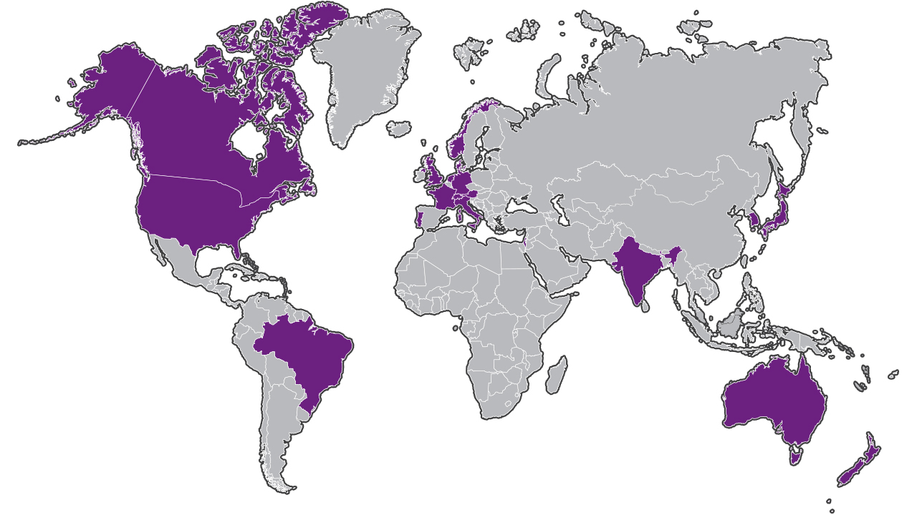
A Growing Global Movement
Australia, Austria, Brazil, Canada, Denmark, England, France, Germany, India, Israel, Italy, Japan, Netherlands, New Zealand, Norway, Portugal, South Korea, South Africa, Switzerland, United Kingdom, United States

Slide 9
Washington State
Washington State Choosing Wisely Task Force:
David Buchholz, MD, Premera Blue Cross
Andrea Carter, MD, Samaritan Healthcare
Marisa D’Angeli, MD, Washington State Department of Health
Christopher Dale, MD, MPH, Swedish Medical Group
Tanny Davenport, MD, MMM, SignalHealth
Connie Davis, MD, Skagit Regional Health
Scott Foster, MD, MPH, PeaceHealth Medical Group
Matt Handley, MD, Kaiser Permanente, Washington
Kent Hu, MD, MPH, The Everett Clinic
Camille Johnson, MD, Virginia Mason
Dan Kent, MD, United Healthcare Community Plan
Gary Knox, MD, Rockwood Clinic
Scott Kronlund, MD, Northwest Physicians Network
Pat Kulpa, MD, MBA, Regence BlueShield
Francis Mercado, MD, CHI Franciscan Health System
Randy Moseley, MD, Confluence Health
Scott Ramsey, MD, PhD, Fred Hutchinson Cancer Research Center
John Robinson, MD, SM, First Choice Health
Pam Sheffield, MD, University of Washington (UW) Medicine
Jae Sim, MD, Edmonds Family Medicine
John Vassell, MD, Qualis Health
Notes:
The Washington Health Alliance, the Washington State Medical Association, Washington State Hospital Association and health care leaders across the state have partnered to create the Washington State Choosing Wisely Task Force. The Task Force champions and disseminates the principles and resources of Choosing Wisely and the leaders are committed to ensuring safe, high-value care for patients in Washington State by significantly reducing health care overuse and waste. They strive to change behaviors and create measurable improvement through education, building practice models and frameworks, and developing resources for providers and health care systems. The task force has been focusing specifically on reducing the use of pre-operative testing.
The Task Force has a shared virtual space and members provide metrics on their three focus areas. They meet quarterly and have several work groups focused on specific populations and areas of interest. The Task Force has created several tools for implementation including a change manual, technical specifications and a physician toolkit. The group also conducts several webinars per year to help spread learnings and implementation and holds a yearly Summit to discuss Choosing Wisely in person.
Results from grantees:
64% of members actively measuring and implementing specific interventions to reduce inappropriate prescribing of antibiotics
KP Washington
Reduction of Antibiotic Use -38%
Reduction of Annual Paps -17%
Swedish
Reduction of Antibiotic Use -21%
Reduction of Annual Paps -8%
Virgina Mason
Reduction of Antibiotic Use -16%
Underlying strengths of the Washington State initiative include a culture of collaboration between multi-stakeholder organizations, professional organizations and health systems. The state had an early awareness and interest in Choosing Wisely and adopted the campaign prior to any grants being provided. The existence of an all-payer claims database helped the state present an accurate picture of overuse and creates a burning platform.

Slide 10
“First, Do No Harm: Calculating Health Care Waste in Washington State”
From 2014 to 2017:
51% were found to be low-value (4,860,902);
~846,973 individuals received at least one low-value service per year
an estimated $703 million was spent on low-value care
10 areas of low-value care accounted for more than 90% of all low-value care
10% decrease for the commercially-insured
24% decrease for the Medicaid-insured
Notes:
A new report from the Washington Health Alliance, utilizes the MedInsight Health Waste Calculator, to produce an analysis of low-value health care services across the state using the Alliance’s All-Payer Claims Database representing approximately 2.4 million commercially insured lives in the state of Washington.

Slide 11
Virginia Statewide
Create a Health System Learning Community To Reduce Provider-Driven Low Value Care
Outreach & Orientation | Speaker Series & Office Hours | Educational Materials | Data Reports & Feedback Trainings | Online Learning Community | Strategy Surveys | Combined Conference
Create an Employer Task Force on Low Value Care
Six Facilitated Meetings | Educational Materials | Staff Support for Action Planning | Online Learning Community | Combined Conference

Slide 12
Center for Healthcare Research and Transformation – Key Themes
Involvement of multiple stakeholders
Dedication of staff time/resources
Measurement and data collection
Resource sharing among stakeholders
Clear and regular communication
Supportive leadership
Clear vision

Slide 13
Ways We Can Support Your Work
Convene Members
Share best practices
Curate tools, materials and resources for implementation
Learning Network
Led by ABIMF
Assistance from ABIMF
Join existing Learning Network

Slide 14
PRESENTS
An initiative generously supported by the

Slide 15
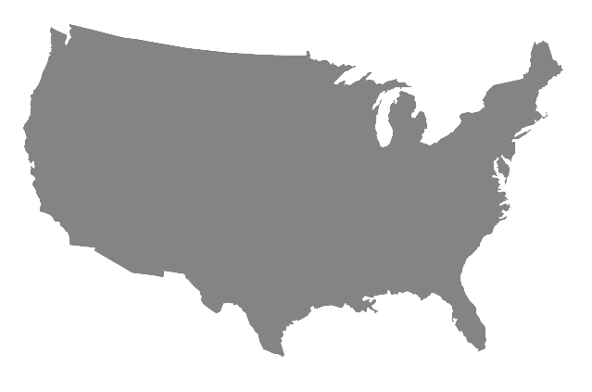
Choosing Wisely-RI State-Wide Model
RI 1st CW State
Statewide campaign launched by the RI Business Group on Health (RIBGH)
Targeting RI employers of all sizes and industries, healthcare providers, and consumers of healthcare services
Similar approach as Seat Belt and Anti-smoking Campaigns
Governor Raimondo declared RI a Choosing Wisely State
The State Legislature Passed Resolution to Support CWRI
Supported by the RI Department of Health, RI Medical Society, Hospital Association of Rhode Island, RI Foundation & Health Plans
Campaign has reached 500,000 + people and growing

Slide 16
The Choosing Wisely-RI Campaign is Growing!
Warwick Senior Center
DESIGN FABRICATORS
Hospital Association of RI
Scituate Senior Center
University Medicine
SMITHFIELD SENIOR CENTER
Tiverton Senior Center
EAST PROVIDENCE SENIOR CENTER
Kahn Litwin Renza
Benjamin Church Senior Center
Coventry Senior Center
Town Of Cumberland Senior Center

Slide 17
CW-RI Participating Physician Groups

Slide 18
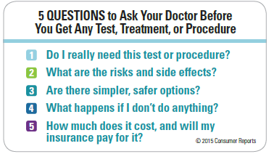
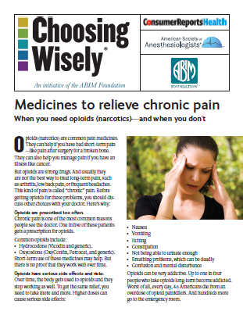
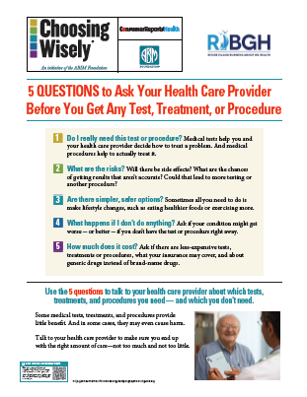
RIF Funded Tools
Printing of 5 Question Posters & Other Resources
Creation of CW-RI Facebook & Web Pages
Creation of Bi-lingual Choosing Wisely Patient Information
Videos
Dr. Bledsoe https://youtube.com/watch?v=IzNaNSImYT4
Dr. Brennan https://youtube.com/watch?v=mY5JI-ivOEQ
Dr. Rodriguez https://www.youtube.com/watch?v=uDw7dQ93wcI
TV Ad https://youtube.com/wYPhYUDNq5k

Slide 19
CW-RI Campaign & RI Cost Trend Steering Committee
Support Creation of CW-RI State-Wide Physician Group
Physicians
Medical Society
Insurers
Health Centers
Others
Support Use of RI-APCD (HealthfactsRI) to:
Create Annual Survey of Waste
Support Targeted Waste Reduction

