Slide 1
Rhode Island Health Care Cost Trends Steering Committee
10th Meeting
September 4, 2019

Slide 2
Agenda
Welcome!
Phase II of the Cost Trends Project
Data Use Strategy Implementation
Sustainability
Break
Revisiting the Target Methodology
Updates
Public Comment
Next Steps and Wrap-Up

Slide 3
Welcome!

Slide 4
Welcome!
Welcome to the first Steering Committee meeting of Phase II of the Cost Trends work.
During Phase I we:
established a cost growth target, and developed an implementation manual containing technical specifications for reporting;
studied and tested the ACPD and produced initial analyses demonstrating APCD viability for analyses of cost drivers and cost trend drivers, as well as analyses that could support cost growth reductions and quality improvement, and
created a plan for the design and production of APCD reports intended to inform and motivate improved health care system performance.

Slide 5
Phase I Steering Committee Members
We appreciate all of you for having given your time, attention, intellect and judgement to this process and your continued commitment.
Tim Babineau, MD, Lifespan
Al Charbonneau, RI Business Group on Health
Tom Croswell, Tufts Health Plan
Adriana Dawson, Bank Newport
Jim Fanale, MD, Care New England
Stephen Farrell, United Healthcare of New England
Marie Ganim, PhD, Co-Chair, Office of the Health Insurance Commissioner
Peter Hollmann, MD, Rhode Island Medical Society
Kim Keck, Co-Chair, Blue Cross Blue Shield of RI
Al Kurose, MD, Co-Chair, Coastal Medical
Peter Marino, Neighborhood Health Plan of RI
Betty Rambur, PhD, RN, FAAN, University of RI School of Nursing
Sam Salganik, Esq., RI Parent Information Network
John Simmons, RI Public Expenditure Council
Neil Steinberg, RI Foundation
Teresa Paiva Weed, Esq., Hospital Association of RI
Larry Wilson, The Wilson Organization, LLC

Slide 6
New Steering Committee Members
We also would like to thank new Steering Committee members for joining us for the second phase of this work.
Angela Bannerman Ankoma, Executive Vice President, Director of Community Investment, United Way
Tony Clapsis, Vice President, CVS Health
Diana Franchitto, President and CEO, Hope Health
Alema Karim, PhD, Chair of Economics and Finance, Rhode Island College
Jim Loring, CFO, Amica Mutual Insurance Company
Patrick Tigue, Medicaid Program Director, Rhode Island EOHHS

Slide 7
Phase II of the Cost Trends Project

Slide 8
Phase II of the Cost Trends Project
The Peterson Center on Healthcare informed the Governor on August 1st that it was awarding a second grant to Brown University to support further Cost Trends Project work.
Peterson awarded an 18-month grant, effective September 1, 2019.
The following slides provide an overview of the planned work for the 18-month period.

Slide 9
Phase II of the Cost Trends Project
Data Use Strategy Implementation
Design standard reports for routine production as outlined in the Data Use Strategy finalized in the spring. These will be developed in priority order as outlined in the Data Use Strategy.
Research report design options and convene an advisory group on report design once per month to provide input to Brown report developers.
Vet findings with payers/providers.
Put reports into regular production and make them available online.
Identify appropriate stakeholders to review report findings.

Slide 10
Phase II of the Cost Trends Project
Data Use Strategy Implementation (cont’d)
Consider report results and make recommendations to act upon report findings.
The Steering Committee shall deliberate on the translation of analyses into action by a range of potential parties.
The State shall be responsible for translating analyses into action. This will be done considering feedback of the Steering Committee, state agencies, and other RI stakeholders, as appropriate.
= involvement of the Steering Committee

Slide 11
Phase II of the Cost Trends Project
Perform Ad Hoc Analyses
These will be conducted as requested by the Steering Committee to address policy questions and by the State to inform and support regulatory functions.
Cost Growth Target Implementation
Finalize the cost growth target implementation manual, which includes a formal request to collect data from payers, including Medicaid (completed).
Host forums to educate insurers about the data request, starting with baseline data, and begin collaborative work to obtain needed data (completed).
Collect baseline 2017 and 2018 data (October-November 2019).
Assess performance against the cost growth target for 2019 (Q4 2020).
The Steering Committee shall review baseline and Year 1 analyses.

Slide 12
Phase II of the Cost Trends Project
Cost Growth Target Implementation (cont’d)
Develop a definition of "significant changes in the economy” that could trigger re-visiting the cost growth target before 2023 considering input from the Steering Committee.
Update the cost growth target implementation manual to include a recommended process for defining the cost growth targets for CY2023 and beyond (Q1 and Q2 2020).

Slide 13
Phase II of the Cost Trends Project
Stakeholder Engagement
Add additional stakeholders to the Steering Committee (completed).
Hold quarterly Steering Committee meetings.
Convene monthly provider collaborative meetings to discuss and apply new standardized report findings to improve health system performance (beginning summer/fall 2020).
Present findings of analyses to legislators and staffers.
Hold annual public meetings

Slide 14
Phase II of the Cost Trends Project
Sustainability
Perform outreach to the state's largest TPAs and employers to solicit their support to submit claims data to HealthFacts RI (in progress).
Plan for budgeting and staffing of required functions to continue the work of the Cost Trends Project after the grant period.
Develop documentation and provide training to assist the State with assumption of responsibility for a) APCD-based reports and b) analysis of payer reporting to assess cost growth target performance.

Slide 15
Scope of Steering Committee Work
During Phase II, the Steering Committee will advise the State on the following topics:
methodological and reporting questions related to the cost growth target;
direction and presentation of intensive analytics;
oversight of the data use strategy, and
coordination of quality work with the cost trend work.
In the fall, the Steering Committee will also begin to discuss a structure to institutionalize the cost trends work (e.g., could the HCPAC be a means to institutionalize the project)?

Slide 16
Data Use Strategy Implementation
Report Design Work Group
Ad hoc Analyses

Slide 17
Report Design Work Group
To implement the data use strategy finalized during Phase I, Brown is convening a new Report Design Work Group.
The work group will collaborate with Brown University to consider what report designs are most effective for routine publication, advise on refinements to reports, and discuss what ad hoc analyses may be of value.
It will also discuss statistical considerations, and processes for vetting report results with providers prior to publication.
The work group will meet once a month for 1.5 hours from October through March, with additional meetings anticipated to occur less often after March.

Slide 18
Report Design Work Group Participants
BCBSRI – Matt Collins
Brown Ctr for Informatics – Neil Sarkar
Brown Physicians – Jay Schuur
BVCHC – Jon Mudge
CharterCare – Kim Labarbera and Bill Webb
Coastal – Mice Chen and Ed McGookin
EOHHS – Kim Paull
Hilb Group – Rob Calise
IHP – Michael Lichtenstein
Integra – Melanie Brites and Matt Harvey
Medicaid – Rebecca Lebeau
PCHC – John Gates, Andrew Saal, and Ed Smith
Prospect – Garry Bliss and Chris Dooley
RIBGH – Al Charbonneau
RIPEC – John Simmons
RI Medical Society – Peter Hollmann
RIPCPC – Andrea Galgay
RIPIN – Shamus Durac

Slide 19
Ad Hoc Analyses
The Data Use Strategy notes that there are two types of Cost Trends Project-related analyses that can be performed with HealthFacts RI data.
A series of routinely produced, commonly structured analyses to be published on a regular schedule (outlined in the Data Use Strategy).
Ad hoc analyses focusing on discrete topics of interest to the State and Rhode Island stakeholders.
The Steering Committee will discuss an approach to these analyses during a future meeting.

Slide 20
Sustainability

Slide 21
Sustainability
As discussed earlier, the Peterson Center on Healthcare has enthusiastically committed to 18 months of continuing support to the Cost Trends Project.
We have previously anticipated the need to secure funding for ongoing support through the Governor’s budget and legislature, and perhaps through private funders, and will be seeking your guidance and support as we discuss this during future meetings.

Slide 22
Break

Slide 23
Revisiting the Target Methodology

Slide 24
When to revisit the target methodology?
In the Compact to Reduce the Growth in Health Care Costs and State Health Care Spending in Rhode Island the Steering Committee wrote:
“Only highly significant changes in the economy will trigger re-visiting of the target methodology. The Steering Committee will work with the state to determine a functional definition of “highly significant” and develop a plan for handling such events.”
This was added to the Compact in an attempt to address the possibility of a sudden sharp decline in the economy, as we saw occur about 10 years ago.

Slide 25
What is the relationship between the economy and health care spending?
We performed some research and consulted with David Cutler (Harvard economist) on the relationship between the economy and health care spending. (Research summary available in the appendix to these slides.)
The bottom line is:
We know that the economy (whether measured through inflation, GDP or personal income growth) affects health care spending. When the economy goes down, so too does health care spending (and vice versa).
We also know the effect lags in for each of the indicators by 2-6 years (depending on the indicator), with a margin of 1-3 years.

Slide 26
Central Question for the Steering Committee
Given what we know about the relationship of the economy to health care spending, should the Steering Committee make a change to the health care cost growth target (which has been set for the next three years) for large changes in inflation, GDP or personal income growth?
The Steering Committee Co-Chairs recommend not making any changes, because the lag in the relationship is significant and any significant change in the economy will not affect health care spending in the near term.
This would mean that, counter to the compact language, highly significant changes in the economy would not trigger re-visiting of the target methodology for the multi-year target period (but could influence future multi-year cost target periods).

Slide 27
Updates
Missing data
Provider attribution
Implementation manual
TME Calculation

Slide 28
Updates on Missing Data from the APCD Analyses
During the 4/15 Steering Committee meeting, we shared analyses of the APCD. These analyses revealed a few areas of missing data.
During the 5/14 stakeholder meeting, we shared that the State was in the process of updating these missing data in the APCD.
Since then...
We received updated BCBSRI and UHC data into the APCD. Brown will shortly receive the new data.
Onpoint could not replicate the NHPRI inpatient data issue that Brown identified. We found that there was an issue with how Brown was viewing the data. When looking at only commercial members in Rhode Island with 12 months of continuous enrollment, the inpatient values are consistent between Brown’s calculations and the underlying APCD data.

Slide 29
Provider Directory Data: Aggregation & Attribution
Brown University

Slide 30
“Two-Step” Process
Objective: To attribute patients in the Rhode Island APCD to the appropriate primary care physician (PCP) for the year 2017
(1) PCP directory aggregation
Compile provider directory data supplied by four payers (UHC, BCBSRI, Tufts, NHPRI) into one dataset that can be used for the patient-to-PCP attribution process
The resultant dataset to have each record correspond to ONE UNIQUE PROVIDER
(2) Patient-to-PCP attribution
Merge dataset from Step (1) to the APCD data
Run a programming algorithm to attribute Rhode Island’s patients to an individual PCP

Slide 31
(1) PCP Directory Aggregation – Data Structure & Formatting
Each record in each payer’s provider directory has unique (NPI) x (PCP Site Name) combinations with various data on where each provider practices and with whom they have contractual relationships
Variation across payer data submission in:
Data entry format
For example: IRA WILSON vs. Ira Wilson
Level of detail and use of acronyms
For example: North Providence Clinic vs. N Prov Clinic vs. Green University N Prov Clinic
Inclusion/exclusion of middle names
John Peterson Doe vs. John Doe vs. Jonathan P Doe
Many more challenges!

Slide 32
(1) PCP Directory Aggregation – Method
Append the four payers’ datasets together
Clean and standardize the variables (both manually and with software)
Restructure the dataset from a long format to a wide format
“Long”
First Name | Last Name | Cred | PCP Site | ACO
Hace | Oh | PA | Green #1 | Amazing ACO
Hace | Oh | PA | Green #2 | Amazing ACO
Anya | Wallack | MD | Brown #1 | Best ACO
Anya | Wallack | MD | Brown #3 | Best ACO
Deepak | Adhikari | MD | Brown #2 | Best ACO
“Wide”
First Name | Last Name | PA | MD | Green1 | Green2 | Brown1 | Brown2 | Amazing | Best
Hace | Oh | Yes | No | Yes | Yes | No | No | Yes | No
Anya | Wallack | No | Yes | No | No | Yes | Yes | No | Yes
Deepak | Adhikari | No | Yes | No | No | Yes | No | No | Yes

Slide 33
(1) PCP Directory Aggregation – Lessons Learned
There is need for further standardization of:
Data entry formatting
Naming of
Providers
Provider Sites
Larger Provider Organizations
All other pertinent variables
Automated processes and minimal use of manual procedures will lead to increased efficiency and accuracy of APCD provider directory maintenance

Slide 34
NEXT: Patient-to-PCP Attribution

Slide 35
(2) PCP Attribution – Needed materials
Aggregated PCP directory dataset (from “Step 1”)
APCD claims data (merge with PCP directory dataset)
Statistical programming software

Slide 36
(2) PCP Attribution – Method
Based on an algorithm developed by RTI which attributes a patient to a provider for each month in a given year
For each R.I. resident, we count visits to primary care physicians (PCPs) over a 27-month “look-back” period for each month of attribution

Slide 37
(2) PCP Attribution – Method
CPT-4 Codes to Identify Eligible Visits
Evaluation and Management - Office or Other Outpatient Services New Patient: 99201-99205 Established Patient: 99211-99215
Domiciliary or Rest Home Care New Patient: 99321–99328 Established Patient: 99331–99337
Home Visit New Patient: 99341–99345 Established Patient: 99347–99350
Preventive Medicine Services New Patient: 99381–99387 * Established Patient: 99391–99397 *
Annual Wellness Visit Welcome to Medicare visit: G0402 Initial: G0438 * Subsequent: G0439 *

Slide 38
(2) PCP Attribution – Results & Lessons Learned from 2017
We identified approximately 1400 unique attributed PCPs from our set of OHIC datasets
We sampled 689,409 unique patients from the APCD database (patients eligible for our project work)
Out of these 689,409 unique patients:
87.6% were attributed to a provider, overall, inclusive of providers not listed in our set of OHIC datasets.
76.3% were attributed to a provider in our set of OHIC datasets
12.4% were not attributed to a provider

Slide 39
Next Steps
Work with Neil Sarkar’s team to develop computer algorithms for autonomized maintenance of R.I. provider directory data
Validity check with 2017 data
Apply to future provider directory data
Execute attribution algorithm with 2018 data

Slide 40
Implementation Manual
On July 31st OHIC made a formal request of insurers to submit data to calculate performance against the health care cost growth target, and shared the final implementation manual and posted it online.
The request was made of BCBSRI, NHPRI, Tufts Health Plan and UnitedHealthcare.
Details of the request are posted here:
http://www.ohic.ri.gov/ohic-reformandpolicy-costtrends.php
Data are due to OHIC by 10/1/2019.

Slide 41
Update to TME Calculation
While the Implementation Manual was being finalized, we found a methodological issue which we changed based on the agreement of the Project Team and the Steering Committee co-chairs.
The Steering Committee compact stated that: behavioral health carveouts were to be excluded from the spending calculation because “most behavioral health coverage in Rhode Island is provided through the insurer, be it for insured or self-insured business, and will be included in the calculation of total health care spending. Steering Committee members noted that the behavioral health carveout spending is small and the trend is stable.”

Slide 42
Update to TME Calculation
When the Steering Committee had originally considered this issue, members believed that there was likely only a few employers who had carved out behavioral health benefits.
However, because we had previously developed a process for insurers to estimate (using sound actuarial principles) the claims payments for carveout services, we instructed insurers to estimate behavioral health carveout spending in the same manner as is done for pharmacy carveout spending, and in the same manner as MA and DE.
Steering Committee staff and the Steering Committee co-chairs believed this change met the intent of the Steering Committee.

Slide 43
Update to TME Calculation
In addition, we also came to learn that Optum is providing behavioral health benefits for UnitedHealthcare and for NHPRI as a carveout contractor.
If United or NHPRI have access to the behavioral health claims paid by Optum, they will be included. When they do not, they will be estimated using the process previously described.

Slide 44
Public Comment

Slide 45
Next Steps

Slide 46
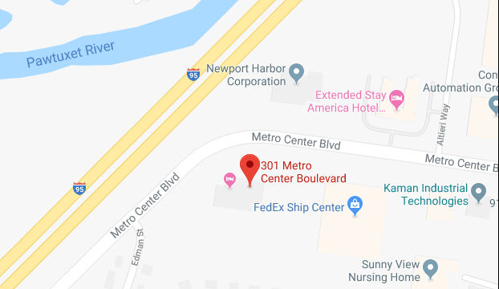
Wrap-Up and Next Meetings
Where: 301 Metro Center Blvd, Suite 203, Warwick, RI 02886
When: Mondays from 9:00 a.m.-12:00 p.m.
December 2, 2019
March 23, 2020
June 8, 2020
September 21, 2020
December 7, 2020

Slide 47
Appendix

Slide 48
The Relationship Between the Economy and Health Care Spending
We found three reputable analyses that look at the relationship between the economy and health care spending.
We can confidently say that the economy does indeed affect health care spending, and that there is a strong relationship between certain economic indicators and the economy, but the effect on health spending occurs over an extended period of time.
The next few slides summarize the evidence we found from these two reports:
Assessing the Effects of the Economy on the Recent Slowdown in Health Spending (2013) Kaiser Family Foundation and Altarum Institute
Health Spending Growth: The Effects of the Great Recession (2015) The Brookings Institution
The Growth of Health Spending in the USA: 1776-2026 (2017) Thomas Getzen, Temple University

Slide 49
What is the Relationship Between the Economy and Health Care Spending? A National Perspective
Kaiser and Altarum developed a statistical model to track how the growth in national health spending varies with macroeconomic indicators and found a strong relationship between inflation and real GDP and health care spending over an extended period of time.
85% of health care spending growth could be predicted using inflation and real GDP over the period 1965-2011.
This model also showed that the effect of the macroeconomy on health care spending lags economic change:
GDP affects health care spending over a period of six years, and inflation does so over two years.

Slide 50
The Great Recession
Because the Steering Committee may be most concerned about the impact of dramatic, severe economic changes, it is instructive to look at the impact of the Great Recession.
When applying this model to examine the effect of the Great Recession on the slowdown in health care spending, Kaiser and Altarum found:
77% of the decline in health care spending that followed the Great Recession could be predicted based on inflation and real GDP.
They did not report on how the lagged impact did or did not change during this period.
How fast health spending grows also depends on the level of “excess health spending” – which is spending growth that exceeds what GDP and inflation predict, and may be due to structural changes in the health care system.

Slide 51
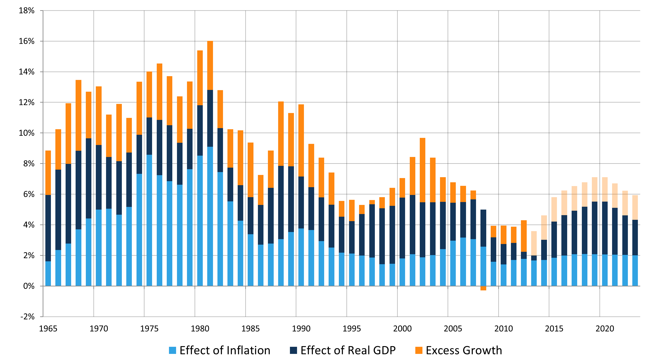
Actual and Projected Growth in Health Spending by Inflation, Real GDP and Excess Growth
First year predicted
Notes:
GDP

Slide 52
A State Perspective
While the Altarum/KFF analysis looked at national spending against national economic indices, a natural question may be whether state-level economic changes affect health care spending.
Louise Sheiner from Brookings analyzed the effect on growth of state health spending on growth of current and lagged personal income growth.
Personal income growth is the total income received by, or on behalf of, all persons from all sources (including wages, SSI, employer benefits, etc.)
States track personal income growth as a measure of a state’s economic trends, as state revenue depends on personal income and spending on government assistance programs.
This is different than looking at GSP, which is the total value of good produced and services provided in the state, however, personal income growth and GSP tend to have similar forecasts.

Slide 53
State Perspective: Key Findings on Non-Medicare Spending
Dental spending is the most responsive to income growth, then, in order of responsiveness, is spending on hospital services, physicians and Rx.
Changes in hospital spending due to personal income takes about six years.
Changes in Rx spending due to personal income are immediate.
Source: L. Sheiner, Brookings Institution www.brookings.edu/wp-content/uploads/2016/06/HealthSpendingGrowth.pdf

Slide 54
More Information About Lagging Effects
Thomas Getzen reviewed historical and contemporary sources to trace the growth of national health expenditures in the US from 1776 (yes!!) to 2026 and found:
There are lags between macroeconomic fluctuations (like GDP, inflation) and changes in health spending of between 3-6 years (with 1 to 3 years margin of error). This supports the Altarum and Brookings findings.
“The arrival of the great recession in 2008-2010 made it abundantly clear that business cycles affect national health spending.”

