Slide 1
Rhode Island Health Care Cost Trends Steering Committee
August 17, 2020

Slide 2
Agenda
Welcome
Experience with COVID-19 and Implications for the Cost Growth Target
Update on Sustainability
Evaluating Performance Against the Cost Growth Target for 2020 and 2021
Baseline 2017-2018 Performance Against the Cost Growth Target
Update on Sustainability
Public Comment
Next Steps and Wrap-Up

Slide 3
Experience with COVID-19 and Implications for the Cost Growth Target

Slide 4
Experience with COVID-19
So much has changed since the Steering Committee last met in February.
COVID-19 has upended our personal and professional lives.
It has resulted in substantive changes in your work, organizational finances and priorities.

Slide 5
Cost Growth Target Relevance During COVID-19
Someone might ask, why Rhode Island should maintain a cost growth target during a time of such economic upheaval?
In fact, it is needed now more than ever. Struggling employers and consumers can’t afford large increases in health spending at a time of economic hardship. State tax revenues are down sharply.
This recognition is reflected in the decision in each of the other states with cost growth targets (DE, MA, OR, and soon, CT) to maintain their use of cost growth targets.
Cost growth also hits the same people who are hardest hit by COVID-19.

Slide 6
Cost Growth Impacts Those Hardest Hit by COVID-19
Source: MA HPC Cost Trends Hearing. 2019. https://www.mass.gov/doc/presentation-2019-cost-trends-hearing-day-one/download.

Slide 7
Implications for the Cost Growth Target
There are at least two implications of COVID-19 for the cost growth target that warrant discussion:
Impact on the Governor’s proposed assessment to support the Cost Trends Project on an ongoing basis
Impact on performance against the cost growth target for 2020 and 2021

Slide 8
Update on Sustainability
As a reminder, during the February 24th Steering Committee meeting, the Steering Committee finalized a sustainability plan.
Given the COVID-19 pandemic and resulting state budget concerns, project staff have been working to consider alternative timelines for the assessment and timing of Peterson funding.
Today we are providing an update on sustainability.
Sustainability Plan
Structure and governance: Maintain the Cost Trends Steering Committee in its present form to make recommendations to the State
Mission: Remain focused on limiting health care cost growth
Functions: No change
Staffing and budget: Staff through OHIC-contracted personnel with an estimated budget of $680K-$1.3M/year.
Financing: Fund through a $1 annual assessment on insured and self-insured commercial lives, plus unspecified additional public and/or private funds

Slide 9
Evaluating Performance Against the Cost Growth Target for 2020 and 2021
Current research estimates a reduction in spending between 2019-2020 as the decrease in spending for non-COVID-19 care is projected to outweigh the increase in spending from COVID-19-related care.
Some research anticipates that a portion of the deferred care from 2020 will occur in 2021¹, leading to a higher-than-expected spending trend from 2020-2021.
¹Rick Kronick estimates that 40% of care not provided in 2020 will be provided in 2021. “How COVID-19 Will Likely Affect Spending, And Why Many Other Analyses May Be Wrong, " Health Affairs Blog, May 19, 2020. DOI: 10.1377/hblog20200518.567886.

Slide 10
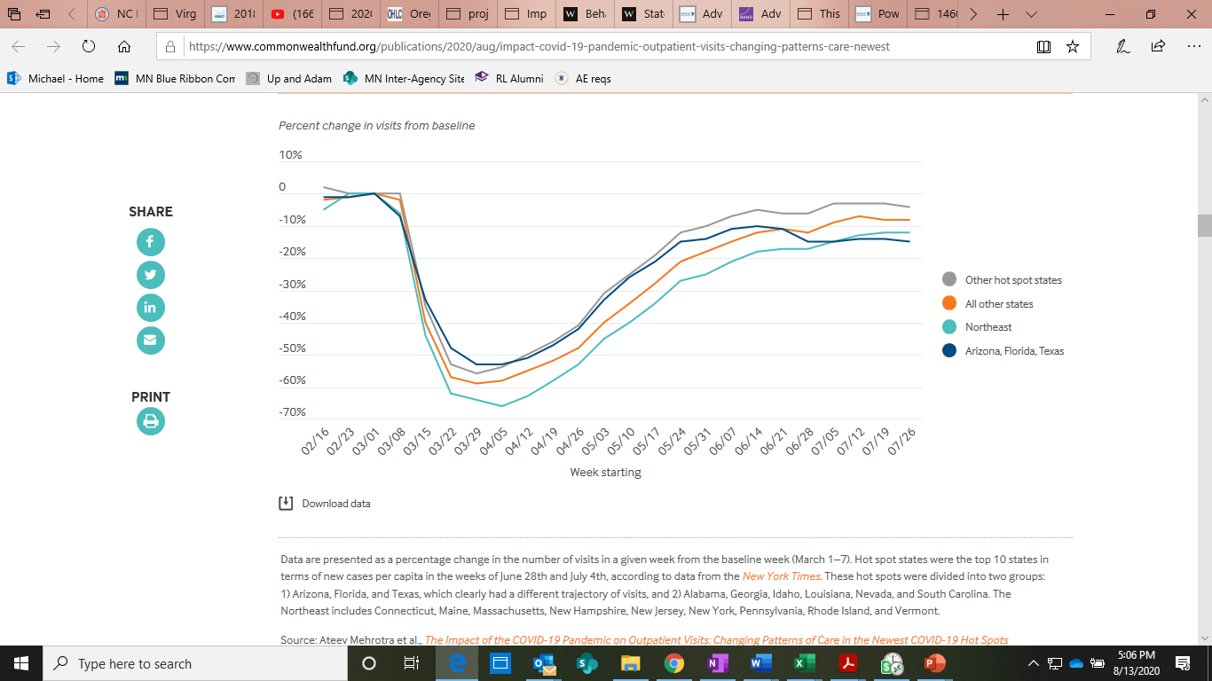
Percentage Change in Outpatient Visit Volume from March 1-7, 2020
Notes:
Source: https://www.commonwealthfund.org/publications/2020/aug/impact-covid-19-pandemic-outpatient-visits-changing-patterns-care-newest and

Slide 11
Evaluating Performance Against the Cost Growth Target for 2020 and 2021
There are at least two potential approaches to evaluating 2020 and 2021 performance:
Acknowledge each year as producing aberrant results, much as MA did with Solvaldi and a major malfunction of its health insurance marketplace one year.
Assess performance for 2020 and 2021 by looking at a 2-year compounded annual rate, assuming (for now) a rebound in 2021.
What are the Steering Committee recommendations regarding these two options for evaluating performance against the target for 2020 and 2021?

Slide 12
Baseline 2017-2018 Performance Against the Cost Growth Target

Slide 13
Background
In December 2018 the Cost Trends Steering Committee established an annual cost growth target of 3.2% per capita for 2019-2022. Data to evaluate the first year of performance will be gathered from public and private payers later this year.
In order to calculate the per capita cost trend for the year preceding the cost growth target, OHIC requested that the state’s four largest insurers submit total medical expense data in October for calendar years 2017 and 2018. Data were also gathered from Medicare, and from Medicaid for non-MCO expenditures.
Payers were asked to follow the specifications outlined in the July 31, 2019 Cost Trends Implementation Manual when preparing their submissions.
Notes:
Notes:
The state’s four largest insurers submitted Medicaid MCO and Medicare Advantage data.
Data from Medicare Part D plans was not captured.
Data on spending from the Veteran’s Health Administration was not collected.

Slide 14
Validation of Baseline Performance Data
Project staff performed a two-part validation process on insurer-submitted data.
Completeness check
Reasonableness check using publicly available benchmarks and other data
Following the initial validation process, project staff worked with insurers to improve their data submissions.
Project staff also calculated the Net Cost of Private Health Insurance (NCPHI) using publicly available data sources.
NCPHI represents insurer administrative expense plus margin.
Finally, staff at Gorman Actuarial provided a peer review of the results.
Notes:
Notes:
Medicare FFS data came directly from CMS and therefore, was not validated by project staff.
Medicaid FFS data came from EOHHS and project staff worked with EOHHS to ensure the data were reasonable.

Slide 15
Baseline Performance: Notes of Caution
The baseline performance results cannot be compared to Brown’s analysis of All-Payer Claims Database (APCD) data. Insurer-submitted data includes the following, which are not found in APCD data:
Non-claims payments
Self-insured population
Pharmacy rebates
The baseline performance results cannot be compared to other publicly available measurements of health spending for similar reasons.
Payer data submissions were validated, but not audited. We cannot be certain that each payer performed the calculations correctly. Project staff have been sharing with each insurer its own specific data relative to overall trends by market as one final review.
Notes:
Notes:
There may be a lot of reasons why other publicly available measures of health spending are not comparable. They include:
Different data specifications
Project staff know of no other spending analysis that analyzes resident populations only
These data are net pharmaceutical rebate spending and project staff know of no other spending analysis that accounts for Rx rebates

Slide 16
Using Different Data Sources to Inform Understanding
Payer-Reported aggregate Data
APCD Analyzed data
Primary purpose: assess performance against the cost growth target
Payer-reported data are provided in aggregate and are limited in detail, but do represent all health care spending in the state (including spending in self-insured employer benefit programs).
Primary purpose: identify underlying cost and cost growth drivers
APCD data are more detailed than payer-reported aggregate data. Claims-level analyses can be performed. While not all state spending data are included, there is more than enough to understand underlying trends.
How much did spending increase or decrease from one year to the next?
What is driving overall cost and cost trends? Where are opportunities?

Slide 17
Key Definitions:
Total Medical Expense (TME): The medical expenses incurred by Rhode Island residents for all health care services by all payers reporting cost growth data to OHIC. TME is reported net of pharmacy rebates.
Net Cost of Private Health Insurance (NCHPI): Measures the cost to Rhode Island residents associated with the administration of private health insurance (including Medicare Advantage and Medicaid managed care). It is defined as the difference between health premiums earned and benefits incurred, and consists of insurers’ cost of paying bills, advertising, sales commissions and other administrative costs, premium taxes and profits (or contributions to reserves) or losses.
Total Health Care Expenditures (THCE): TME plus NCPHI. THCE is reported net of pharmacy rebates.

Slide 18
State Total Health Care Expenditures
Aggregate Annual Trend
Per Capita Annual Trend
NCPHI
Commercial
Medicaid
Medicare
14.9%
1.9%
5.8%
4.4%
3.6%
2017
2018
2017
2018
Total Spending:
Per Capita Spending:
$7.40B
$7.73B
$7,001
$7,309
These values are not risk-adjusted and are net of rebates.
Medicare FFS values are gross of rebates, as the State did not receive rebate information from CMS. This slightly overstates Medicare spending.
Notes:
Medicaid accounted for 28% of THCE in 2018.
The NCPHI trend from 2017-2018 was driven by increases in the commercial individual and small group markets.

Slide 19
Total Medical Expense by Market
Aggregate Annual Trend
Per Capita Annual Trend
Trend: 3.4%
Trend: 5.8%
2017
2018
2017
2018
2017
2018
These values are not risk-adjusted and are net of rebates.
Medicare FFS values are gross of rebates, as the State did not receive rebate information from CMS. This slightly overstates Medicare spending.
Notes:
Medicare cannot be reported on a per capita basis due to data limitations in CMS-supplied data.
Spending on NHPRI’s “Integrity” Medicare/Medicaid product population and associated member months was attributed 40% to Medicaid MCO and 60% to Medicare MCO based on NHPRI’s estimate of Medicare and Medicaid spending. Fee-for-service spending on individuals dually eligible for both programs were not separately identifiable in Medicare or Medicaid FFS data which did not allow for duals to be separately reported.
Shrinking commercial market ?

Slide 20
Service Category Trends – State
Category | Trend
Non-claims | 6.5%
Other Claims | 2.7%
Other Professional | 6.2%
Long-Term Care | -1.2%
Professional Physician | 2.9%
Hospital Outpatient | 7.2%
Retail Pharmacy (Net of Rebates) | 9.8%
Hospital Inpatient | -0.9%
These values are not risk-adjusted. Also, pharmacy rebates are included only for the MCO portion of Medicare spending and not for Medicare FFS, which will slightly overstate Medicare spending.
Spending for NHPRI’s Integrity product is excluded from service category spending due to an inability to accurately estimate spending by service category.

Slide 21
Category | 2017-2018 Trend
Hospital Outpatient | 5%
Retail Pharmacy (Net of Rebates) | 2%
Hospital Inpatient | -2%
Professional Physician – Primary Care | -3%
Professional Physician – Specialty Care | 7%
Other Professional | 5%
Other Claims | -2%
Non-Claims | 3%
Long-Term Care | -11%
2017
2018
These values are not risk-adjusted.

Slide 22
Category | 2017-2018 Trend
Hospital Inpatient | -3%
Retail Pharmacy (Net of Rebates) | 12%
Professional Physician | 2%
Hospital Outpatient | 11%
Long-Term Care | -3%
Other Claims | 4%
Other Professional | 4%
Non-Claims | 23%
2017
2018
These values are not risk-adjusted. Also, pharmacy rebates are included only for the MCO portion of Medicare spending and not for Medicare FFS.
CMS did not report specialty physician spending; therefore, all physician spending is categorized together.
Spending on NHPRI’s Integrity population is excluded from service category spending due to an inability to accurately estimate spending by service category.

Slide 23
Category | 2017-2018 Trend
Long-Term Care | 8%
Hospital Inpatient | 2%
Hospital Outpatient | 4%
Other Professional | 10%
Other Claims | 1%
Retail Pharmacy (Net of Rebates) | 23%
Non-Claims | 4%
Professional Physician - Specialty Care | 2%
Professional Physician - Primary Care | 5%
2017
2018
These values are not risk-adjusted.
Spending on the Integrity population is excluded from service category spending due to inability accurately estimate proportion of spending by service category.
Notes:
Notes:
“Other professional consists of payments on the basis of claims to providers for services provided by a licensed practitioner other than a physician. This includes, but is not limited to, community health center services, freestanding ambulatory surgical center services, licensed podiatrists, nurse practitioners, physician assistants, PT/OT/SLP, psychologists, LICSW, counselors, dieticians, dentists and chiropractors.

Slide 24
Service Category Trends – Hospital Care
Spending on outpatient hospital services was the fastest growing category of spending.
Care has been shifted from inpatient to outpatient, consistent with national trends.
Medicare was the primary driver of the overall statewide trend in hospital outpatient spending.
MCO (15%)
FFS (9%)
These values are not risk-adjusted.
Spending on the Integrity population is excluded from service category spending due to inability accurately estimate proportion of spending by service category.
% of Total Spending by Service Category
 | Commercial | Medicaid | Medicare
Inpatient | 19% | 15% | 25%
Outpatient | 25% | 14% | 15%
(increase in hospital outpatient spending)
Notes:
Payer-reported aggregate data can only lend so much insight. APCD analysis would be required to ID to what extent there is a) site of service substitution hospital IP to OP, b) site of service substitution MD office to hospital OP, and c) new OP services and/or volume.

Slide 25
Service Category Trends – Pharmacy
Commercial plans experienced the lowest growth in pharmacy of all markets.
Medicaid had the highest growth rate, but also the lowest overall spending on pharmaceuticals.
Medicare FFS pharmacy spending is not net of rebates due to data limitations.
% of Total Spending by Service Category
 | Commercial | Medicaid | Medicare
Pharmacy (Net of Rebates) | 20% | 7% | 25%

Slide 26
THCE Trends – Net Cost of Private Health Insurance
4%
Medicare MCO plans have the highest admin and margin per member per year.
Greatest overall increases in NCPHI were from the commercial individual and small group markets.
The trend in the individual market was very high, but enrollment was low.
15%
25%
Weighted average based on member months reported by insurers.
PMPY NCPHI Trend by Market Segment
Medicaid MCO | Medicare MCO | Self-Insured | Large Group | Small Group | Individual
4% | 15% | -1% | 13% | 35% | 169%
Notes:
The insurers will be very sensitive to this slide. I think you should explain that NCPHI trend may be volatile due to changes in insurer profitability levels from year to year.

Slide 27
Commercial Market Enrollment
Category | Trend
Self-Insured | -2%
Large Group | -2%
Small Group | -3%
Individual | 4%
2017
2018
Data are presented in member months and represent Rhode Island residents only

Slide 28
Public Comment

Slide 29
Next Steps

Slide 30
Upcoming Meetings
Public Meeting
When: October 2020
Agenda topics:
2017-2018 Baseline performance Against the Cost Growth Target
Panel discussion of the impact of COVID-19 on care delivery
Brown analysis of pharmacy cost trends
NASHP presentation on state legislative pharmacy cost strategies and panel discussion
Steering Committee Meeting
When: October 26, 9:00am-11:00am

