Slide 1
Introduction to the Massachusetts Health Policy Commission and the
Health Care Cost Growth Benchmark
Rhode Island Cost Trends Steering Committee Meeting
December 2, 2019

Slide 2
In 2012, Massachusetts became the first state to establish a target for sustainable health care spending growth.
Chapter 224 of the Acts of 2012
An Act Improving the Quality of Health Care and Reducing Costs through Increased Transparency, Efficiency, and Innovation.
GOAL
Reduce total health care spending growth to meet the Health Care Cost Growth Benchmark, which is set by the HPC and tied to the state’s overall economic growth.
VISION
A transparent and innovative healthcare system that is accountable for producing better health and better care at a lower cost for all the people of the Commonwealth.

Slide 3
Health Care Cost Growth Benchmark
Sets a target for controlling the growth of total health care expenditures across all payers (public and private), and is set to the state’s long-term economic growth rate:
  Health care cost growth benchmark for 2013 - 2017 equals 3.6%
  Health care cost growth benchmark for 2017 - 2019 equals 3.1%
If target is not met, the Health Policy Commission can require health care providers and health plans to implement Performance Improvement Plans and submit to strict public monitoring
  TOTAL HEALTH CARE EXPENDITURES
  Definition: Annual per capita sum of all health care expenditures in the Commonwealth from public and private sources
  Includes:
    All categories of medical expenses and all non-claims related payments to providers
    All patient cost-sharing amounts, such as deductibles and copayments
    Administrative cost of private health insurance

Slide 4
Vision for achieving the health care growth benchmark while improving quality, access, patient engagement, and overall market functioning
Transforming the way we deliver care
1
Reforming the way we pay for care
2
  A more transparent, accountable health care system that ensures quality, affordable health care for Massachusetts residents
Developing a value-based health care market
3
Engaging purchasers through information and incentives
4

Slide 5

Two independent state agencies work together to monitor the state’s health care performance and make data-driven policy recommendations
Massachusetts Health Policy Commission
(HPC)
Center for Health Information and Analysis (CHIA)
  Policy hub
  Independent state agency governed by an 11-member board with diverse experience in health care
  Duties include:
    Sets statewide health care cost growth benchmark
    Enforces performance against the benchmark
    Certifies accountable care organizations and patient-centered medical homes
    Registers provider organizations
    Conducts cost and market impact reviews
    Holds annual cost trend hearings
    Produces annual cost trends report
    Supports innovative care delivery investments
  Data hub
  Independent state agency overseen by a Council chaired by the Secretary of Health and Human Services
  Duties include:
    Collects and reports a wide variety of provider and health plan data
    Examines trends in the commercial health care market, including changes in premiums and benefit levels, market concentration, and spending and retention
    Manages the All-Payer Claims Database
    Maintains consumer-facing cost transparency website, CompareCare

Slide 6
The HPC: Governance Structure
  Governor
  Attorney General
  State Auditor
Chair with Expertise in Health Care Delivery
Primary Care Physician
Expertise in Health Plan Administration and Finance
Secretary of Administration and Finance
Secretary of Health and Human Services
Expertise as a Health Economist
Expertise in Behavioral Health
Expertise in Health Care Consumer Advocacy
Expertise in Innovative Medicine
Expertise in Representing the Health Care Workforce
Expertise as a Purchaser of Health Insurance
Health Policy Commission Board
Dr. Stuart Altman, Chair
Executive Director
David Seltz
Advisory Council

Slide 7
Role of the Health Policy Commission’s Advisory Council
BACKGROUND ON THE HPC’S ADVISORY COUNCIL
Convened in 2013 with a body of 30+ diverse health care leaders and other key stakeholders. The council meets quarterly with the HPC Executive Director and available Board members.
Appointed members include representatives of the largest health systems and health plans in Massachusetts, physician organizations, community hospitals, behavioral health care providers, community health centers, organized labor, nurses, home health care, long term care, pharmaceutical and life sciences industry, social service providers, public health advocates, consumer advocates, equity advocates, multiple large and small employer groups, and sister governmental health care agencies such as the Medicaid program, the state employee health commission, and the state’s health insurance exchange.
Meetings enhance the HPC’s robust policy discussions by allowing for varied perspectives on the issues facing the health care market, including:
  Advising on and providing specific input towards the HPC’s research and policy initiatives;
  Contributing feedback and setting priorities for investment and certification programs;
  Facilitating direct communication between HPC staff, HPC Board members, and a broad distribution of health care industry participants and stakeholders.
1
2
3

Slide 8




The HPC employs four core strategies to realize its vision of better care, better health, and lower costs for all people of the Commonwealth.
RESEARCH AND REPORT
INVESTIGATE, ANALYZE, AND REPORT TRENDS AND INSIGHTS
CONVENE
BRING TOGETHER STAKEHOLDER COMMUNITY TO INFLUENCE THEIR ACTIONS ON A TOPIC OR PROBLEM
WATCHDOG
MONITOR AND INTERVENE WHEN NECESSARY TO ASSURE MARKET PERFORMANCE
PARTNER
ENGAGE WITH INDIVIDUALS, GROUPS, AND ORGANIZATIONS TO ACHIEVE MUTUAL GOALS

Slide 9
The HPC Approach
Collaborate with stakeholders and all interested constituencies in the development of policy.
Engage experts, both within and outside the health care industry.
Encourage innovation without a “one-size fits all approach”.
Coordinate with other local, state, and federal initiatives.
Minimize administrative burden and duplication while maximizing the use of existing resources, including data and information.
Promote public transparency and accountability in all activities of the HPC.

Slide 10
The HPC employs four core strategies to realize its vision of better care, better health, and lower costs for all people of the Commonwealth.
RESEARCH AND REPORT
INVESTIGATE, ANALYZE, AND REPORT TRENDS AND INSIGHTS
CONVENE
BRING TOGETHER STAKEHOLDER COMMUNITY TO INFLUENCE THEIR ACTIONS ON A TOPIC OR PROBLEM
WATCHDOG
MONITOR AND INTERVENE WHEN NECESSARY TO ASSURE MARKET PERFORMANCE
PARTNER
ENGAGE WITH INDIVIDUALS, GROUPS, AND ORGANIZATIONS TO ACHIEVE MUTUAL GOALS

Slide 11
From 2012 to 2018, annual health care spending growth averaged 3.4%, below the state benchmark.
3.1%
This is the third consecutive year it met or fell below the health care cost growth benchmark.
The initial estimate of THCE per capita growth for 2018 is

Slide 12
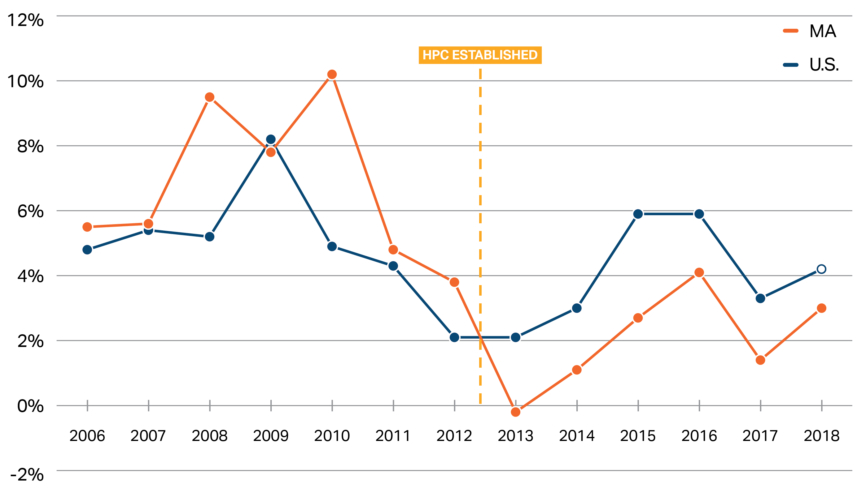
Commercial spending growth in Massachusetts has been below the national rate every year since 2013, generating billions in avoided spending.
Annual growth in commercial medical spending per enrollee, Massachusetts and the U.S., 2006-2018
Notes: U.S. data includes Massachusetts. U.S. data point for 2018 is partially projected. MA data point for 2018 is preliminary.
Sources: CMS National Healthcare Expenditure Accounts, Personal Health Care Expenditures Data (U.S. 2014-2018) ; CMS State Healthcare Expenditure Accounts (U.S. 2000-2014 and MA 2000-2014); CHIA Annual Report THCE Databooks (MA 2014-2018).

Slide 13
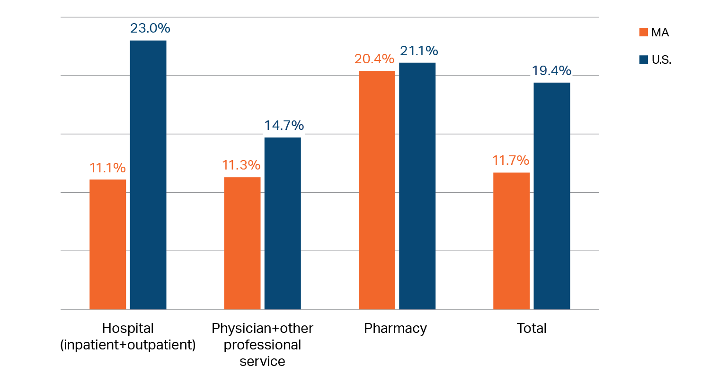
Since 2013, total hospital spending growth (inpatient and outpatient) in Massachusetts has been far below national growth rates
2013 – 2017 cumulative growth in commercial spending by service category, MA and U.S.
If Massachusetts commercial spending grew at the national rate from 2013-2017, residents would have spent $1.7B more in 2017 alone ($367 per person)
Notes: US data include Massachusetts. Pharmacy spending is net of rebates.
Sources: Centers for Medicare and Medicaid Services, National Healthcare Expenditure Accounts, Private Health Insurance Expenditures and Enrollment Data (U.S. 2013-2017); Center for Health Information and Analysis Annual Reports (MA 2013-2017).

Slide 14
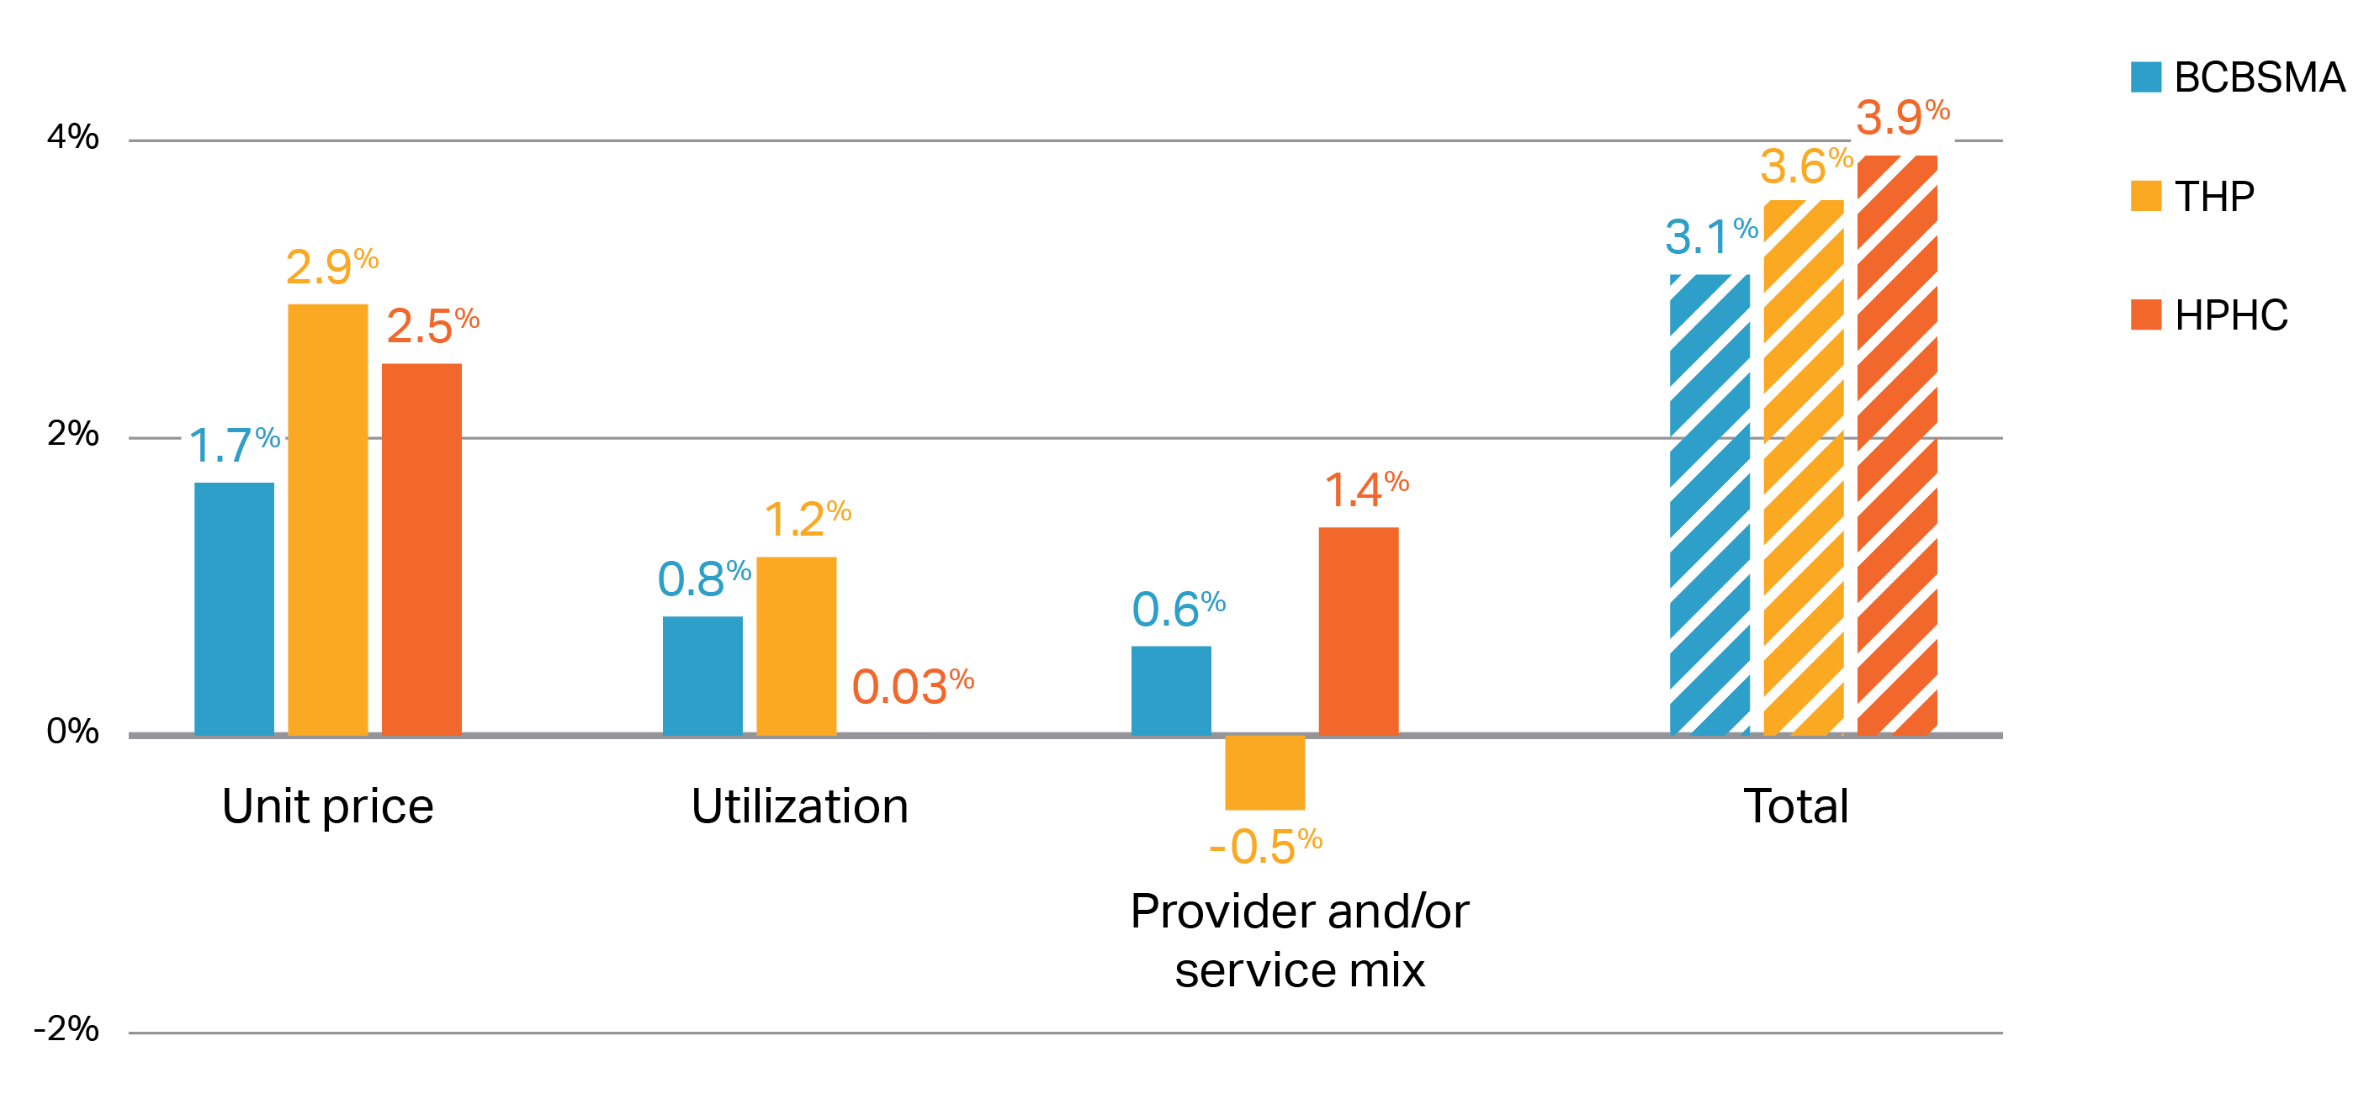
Unit price increases have moderated, and utilization growth is level, leading to lower cost growth among Massachusetts’ largest insurers.
Average annual growth in spending by component for top three Massachusetts payers, 2016-2018
Notes: Average of medical expenditure trend by year 2016-2018. BCBSMA = Blue Cross Blue Shield of Massachusetts; THP = Tufts Health Plan; HPHC = Harvard Pilgrim Health Care.
Source: HPC analysis of Pre-Filed Testimony pursuant to the 2019 Annual Cost Trends Hearing

Slide 15
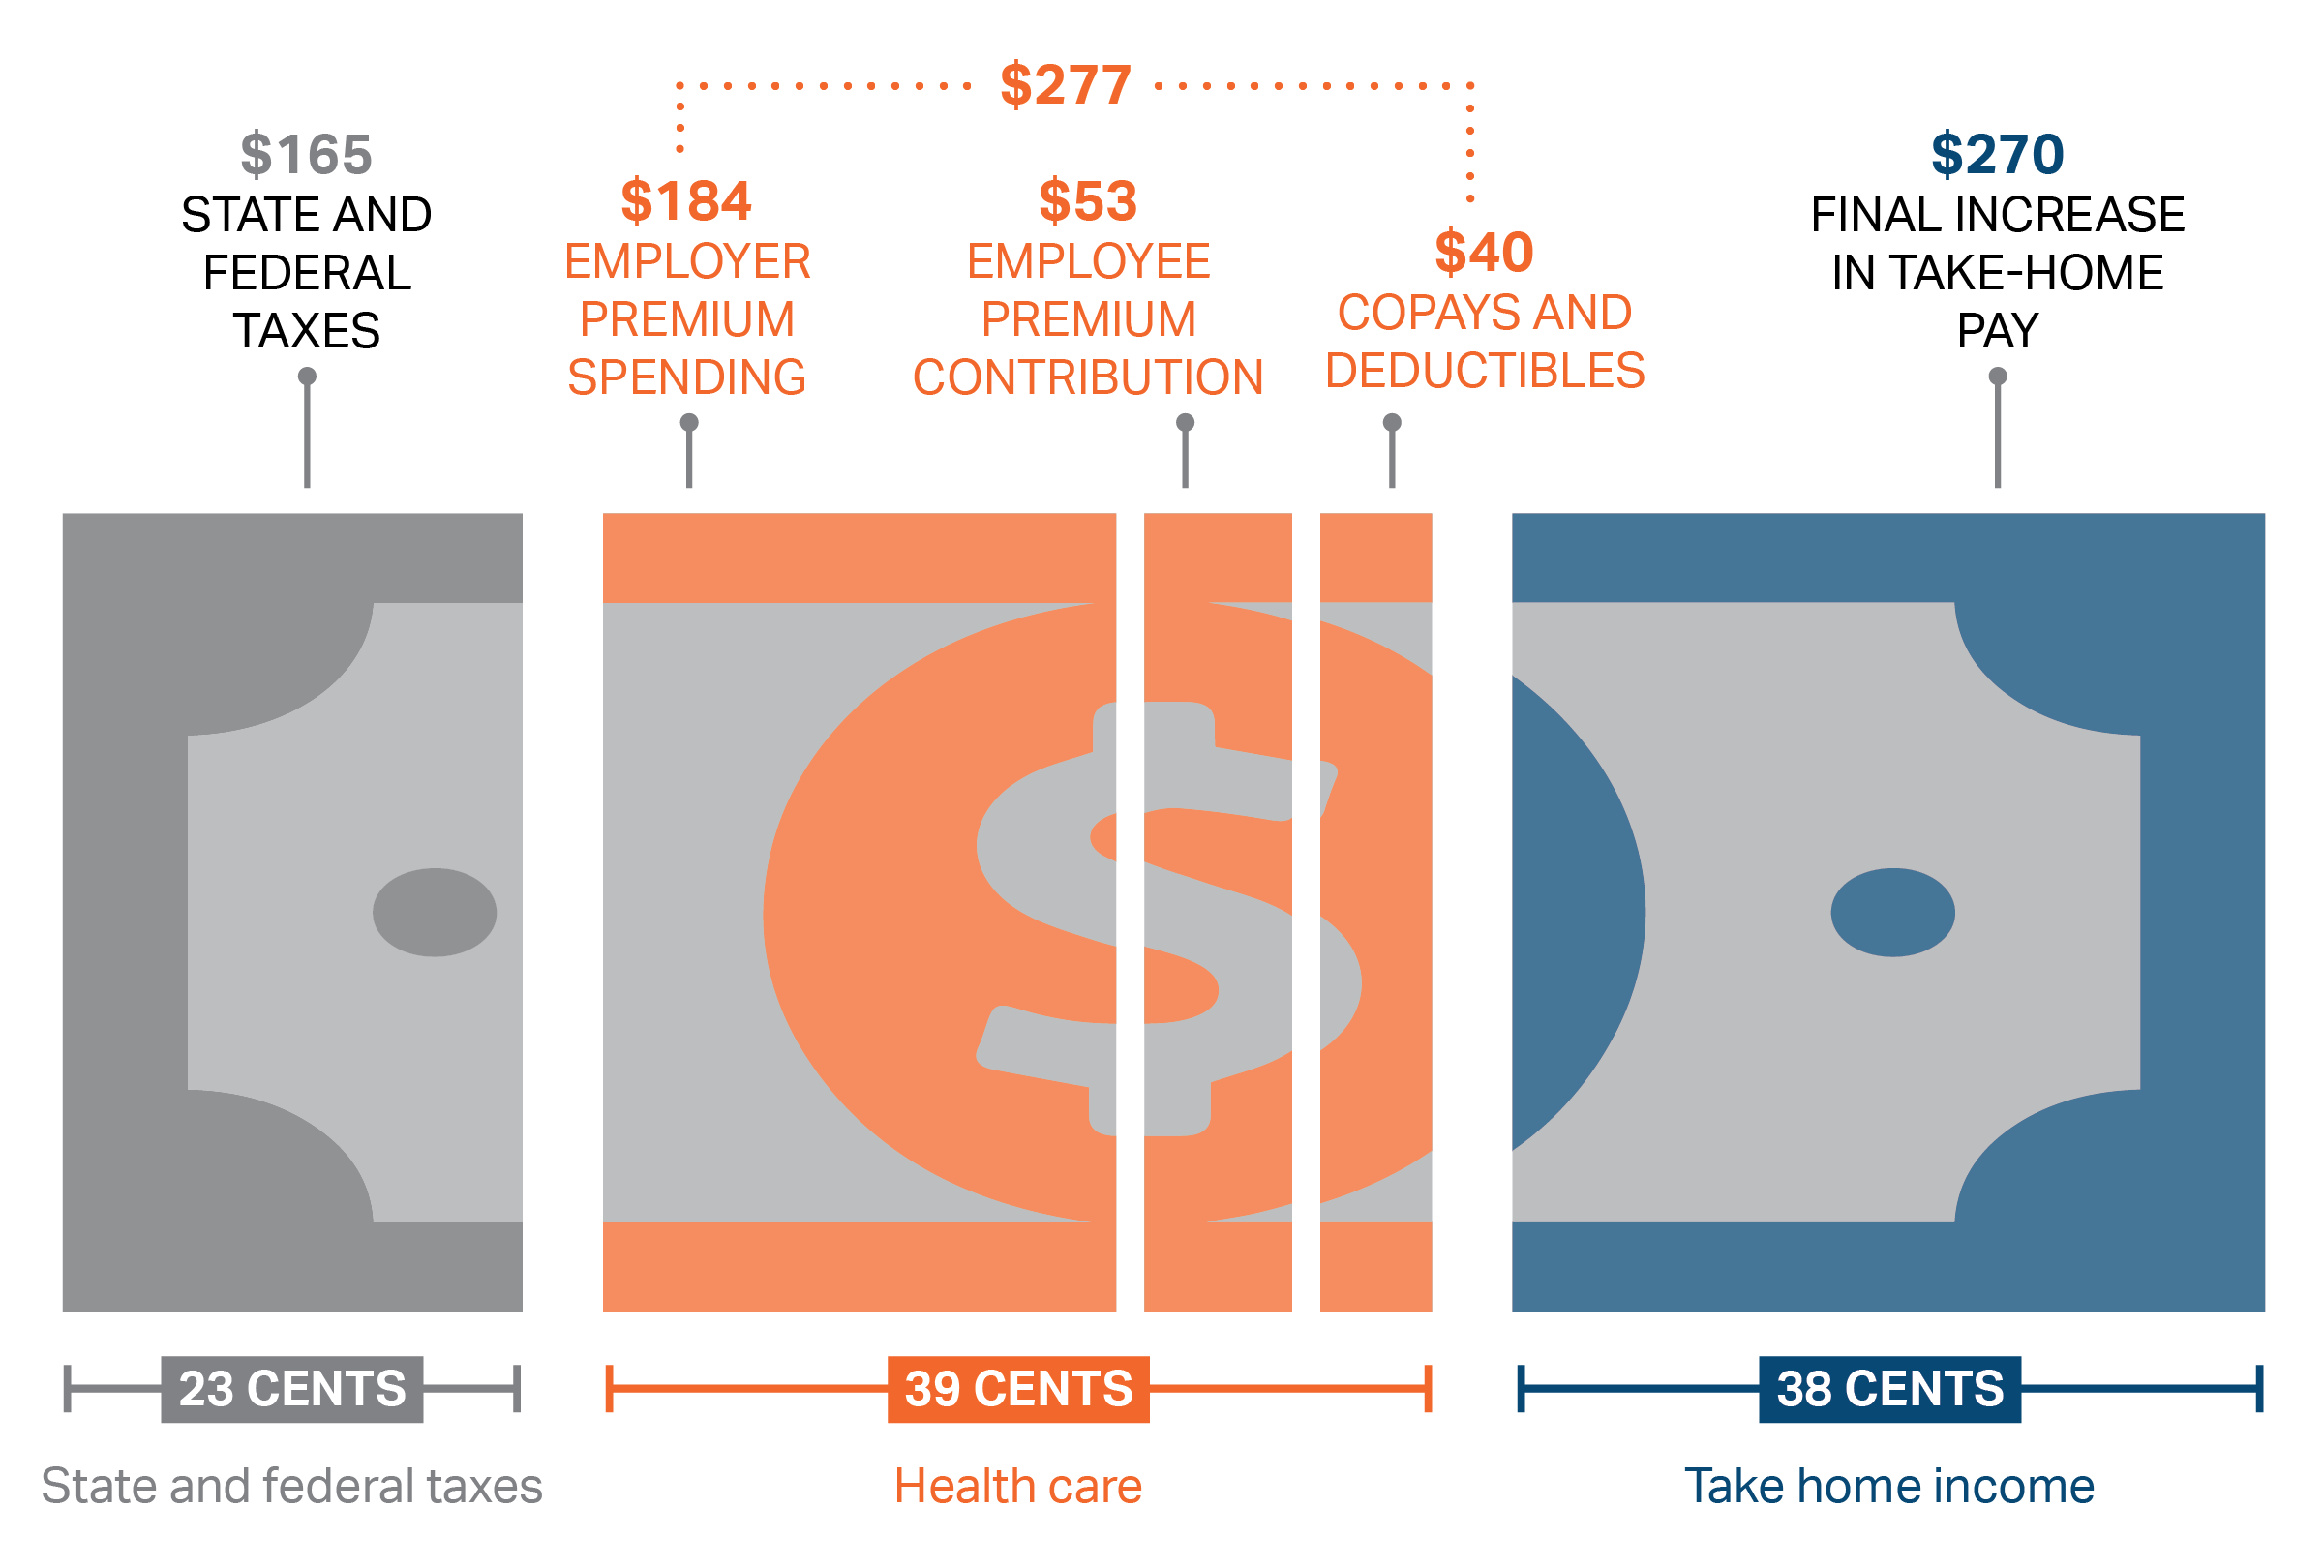
Why focus on health care costs? Nearly 40 cents of every additional dollar earned by Massachusetts families between 2016 and 2018 went to health care, more than take home income.
Allocation of the increase in monthly compensation between 2016 and 2018 for a median Massachusetts family with health insurance through an employer
Notes: Data represent Massachusetts families who obtain private health insurance through an employer. Massachusetts median family income grew from $95,207 to $101,548 over the period while mean family employer-sponsored insurance premiums grew from $18,955 to $21,801. Compensation is defined as employer premium contributions plus income as recorded in the ACS and is considered earnings. All premium payments are assumed non-taxable. Tax figures include income, payroll, and state income tax.
Sources: HPC analysis of Agency for Healthcare Research and Quality (AHRQ) Medical Expenditure Panel Survey Insurance Component (premiums) American Community Survey (ACS) 1-year files (income), and Center for Health Information and Analysis 2019 Annual Report (cost-sharing).

Slide 16
The HPC employs four core strategies to realize its vision of better care, better health, and lower costs for all people of the Commonwealth.
RESEARCH AND REPORT
INVESTIGATE, ANALYZE, AND REPORT TRENDS AND INSIGHTS
CONVENE
BRING TOGETHER STAKEHOLDER COMMUNITY TO INFLUENCE THEIR ACTIONS ON A TOPIC OR PROBLEM
WATCHDOG
MONITOR AND INTERVENE WHEN NECESSARY TO ASSURE MARKET PERFORMANCE
PARTNER
ENGAGE WITH INDIVIDUALS, GROUPS, AND ORGANIZATIONS TO ACHIEVE MUTUAL GOALS

Slide 17
Overview of Cost and Market Impact Reviews (CMIRs)
1
  Market structure and new provider changes, including consolidations and alignments, have been shown to impact health care system performance and total medical spending
  Chapter 224 directs the HPC to track “material change[s] to [the] operations or governance structure” of provider organizations and to engage in a more comprehensive review of transactions anticipated to have a significant impact on health care costs or market functioning
  CMIRs promote transparency and accountability in engaging in market changes, and encourage market participants to minimize negative impacts and enhance positive outcomes of any given material change
2
3

Slide 18
The HPC tracks five different transaction types, many of which are not typically monitored by states.
5 Types of Material Change Notices
Merger, Affiliation or Acquisition by a Carrier
Merger or Acquisition with/by hospital or hospital system
Clinical Affiliation between 2 or more providers (NPSR >25M)
Partnership, joint venture, etc. contracting on behalf of one or more providers
Acquisition, Merger or affiliation (corporate, contracting or employment) by or with another Provider resulting in an NPSR increase of 10M or more, or near-majority market share

Slide 19
Types of Transactions Noticed
TYPE OF TRANSACTION | NUMBER | FREQUENCY
Physician group merger, acquisition, or network affiliation | 23 | 22%
Clinical affiliation | 23 | 22%
Acute hospital merger, acquisition, or network affiliation | 21 | 20%
Formation of a contracting entity | 19 | 18%
Merger, acquisition, or network affiliation of other provider type (e.g., post-acute) | 12 | 12%
Change in ownership or merger of corporately affiliated entities | 5 | 5%
Affiliation between a provider and a carrier | 1 | 1%

Slide 20
Factors for Evaluating Cost and Market Impact of Provider Transactions
Cost
Quality
Access
Public Interest
  Unit prices
  Health status adjusted total medical expenses
  Provider costs and cost trends
  Provider size and market share within primary service areas and dispersed service areas
  Quality of services provided, including patient experience
  Availability and accessibility of services within primary service areas and dispersed service areas
  Impact on competing options for health care delivery, including impact on existing providers
  Methods used to attract patient volume and to recruit or acquire health care professionals or facilities
  Role in serving at-risk, underserved, and government payer populations
  Role in providing low margin or negative margin services
  Consumer concerns, such as complaints that the provider has engaged in any unfair method of competition or any unfair or deceptive act
  Other factors in the public interest
market functioning

Slide 21




Benefits of HPC’s Reviews of Provider Affiliations
The Material Change Notice (MCN) and Cost and Market Impact Review (CMIR) process, in addition to increasing public awareness of provider affiliations, has produced the following benefits for consumers in Massachusetts:
Future Accountability: Requiring entities to disclose goals for a transaction allows the HPC and others to assess whether those goals have been achieved in the future.
Voluntary Commitments: Some entities have addressed concerns raised by the HPC by making certain public commitments (e.g., increasing access for Medicaid patients, not implementing facility fees at acquired physician clinics).
Support for Enforcement Actions: Findings in CMIR reports have been used by the Massachusetts Attorney General and Department of Public Health to negotiate enforceable commitments to address cost, market, quality, and access concerns.
  CMIR findings may be considered as evidence in Massachusetts antitrust or consumer protection actions, and in Determination of Need reviews.
Impacts on Transaction Plans: In some cases, entities have planned affiliations in part based on the likelihood of a CMIR, and in other cases have decided not to pursue an affiliation after the HPC raised concerns in the MCN or CMIR process.

Slide 22





State efforts to reduce cost growth through the benchmark and the work of the HPC continue to receive broad multi-sector stakeholder support
"Given the ongoing challenges with health care affordability for our state’s residents, we believe it’s critically important to continue to pursue approaches that signal to the health care community that current efforts to address costs are insufficient. We therefore recommend that the HPC set the 2018 benchmark at equal to the potential gross state product minus 0.5 percent, or 3.1%."
Consumer Advocate
"As we continue to track trends in health-care cost and utilization, the cost-growth benchmark has become a critical component for understanding year-over-year increases in health-care spending.”
Business
"We strongly believe that the annual health care cost benchmark can be a major tool in achieving the state’s cost goals. The benchmark should be maintained at 3.1 percent and providers should be encouraged to pursue even more aggressive and innovative cost reduction measures."
Business
“MHA supports the goals we all have to address rising costs and to insure that affordable access to healthcare in the commonwealth is sustainable. Moving to a 3.1% benchmark is aspirational and potentially achievable."
Provider
"The Medical Society strongly supports the intent of Chapter 224, and the mission of the Health Policy Commission to develop policy to reduce health care cost growth and improve the quality of patient care. The Medical Society strongly supports thoughtful policies to drive sustainable containment of health care costs below the benchmark on an ongoing basis- whether at 3.6% or 3.1%. "
Provider

Slide 23
The HPC makes annual policy recommendations to the Legislature and Governor on opportunities to achieve health care savings.
The 2018 Annual Cost Trends Report includes a set of eleven policy recommendations necessary to continue progress in achieving the Commonwealth’s goal of better health, better care, and lower costs.
HPC Recommendations by Topics
Administrative Complexity
Pharmaceutical Spending
Out-of-Network Billing
Provider Price Variation
Facility Fee Reform
Demand-Side Incentives
7
Unnecessary Utilization
Social Determinants of Health
Health Care Workforce
Innovations in Integrated Care
Alternative Payment Methods
1
2
8
3
9
4
10
5
11
6
Notes:
Fostering a value-based market in which payers and providers openly compete, and in which providers are supported and equitably rewarded for providing high-quality and affordable services;
Supporting an efficient, high-quality, health care delivery system that improves health by delivering coordinated, patient-centered health care that accounts for patients’ behavioral, social and medical needs;
Advancing aligned and effective financial incentives for providers to deliver high-quality, cost effective care and for consumers and employers to make high-value choices for their care and coverage; and
Enhancing transparency through publicly available data and information on health care system performance in order for providers, payers, patients, employers, and policymakers, including state agencies and the Legislature, to successfully implement reforms and evaluate performance over time.

Slide 24
Contact Information
  For more information about the Massachusetts Health Policy Commission
  Visit us
  http://www.mass.gov/hpc
  Follow us
  @Mass_HPC
  Email Us
  HPC.INFO@mass.gov

Slide 25
Appendix

Slide 26
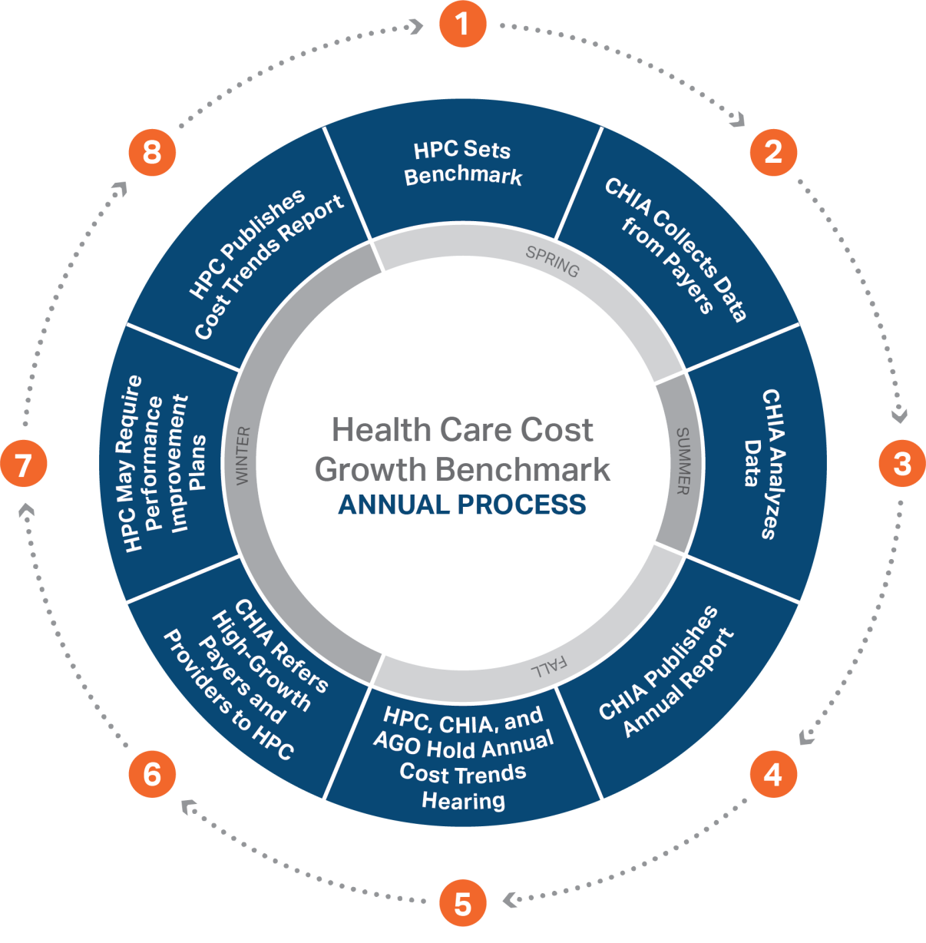
Annual Timeline for HPC and CHIA to Establish the Health Care Cost Growth Benchmark and Evaluate the State’s Performance

Slide 27
The total number of HPC employees has been stable over the past four years, even as agency responsibilities and activities have grown
HPC Employee Headcount: 2013-2019*
FTE by Department, September 1, 2019
Care Transformation and Innovation
17
Market Oversight and Transparency
10.4
Research and Cost Trends
7.4
Internal/External Operations + EXEC
14.2
Legal/Office of Patient Protection
10
Total FTE
59
*Note: This graph includes a headcount of both full time and part time paid employees, including temporary employees. The table below is an adjusted count based on 37.5 hour work week (FTE).

Slide 28
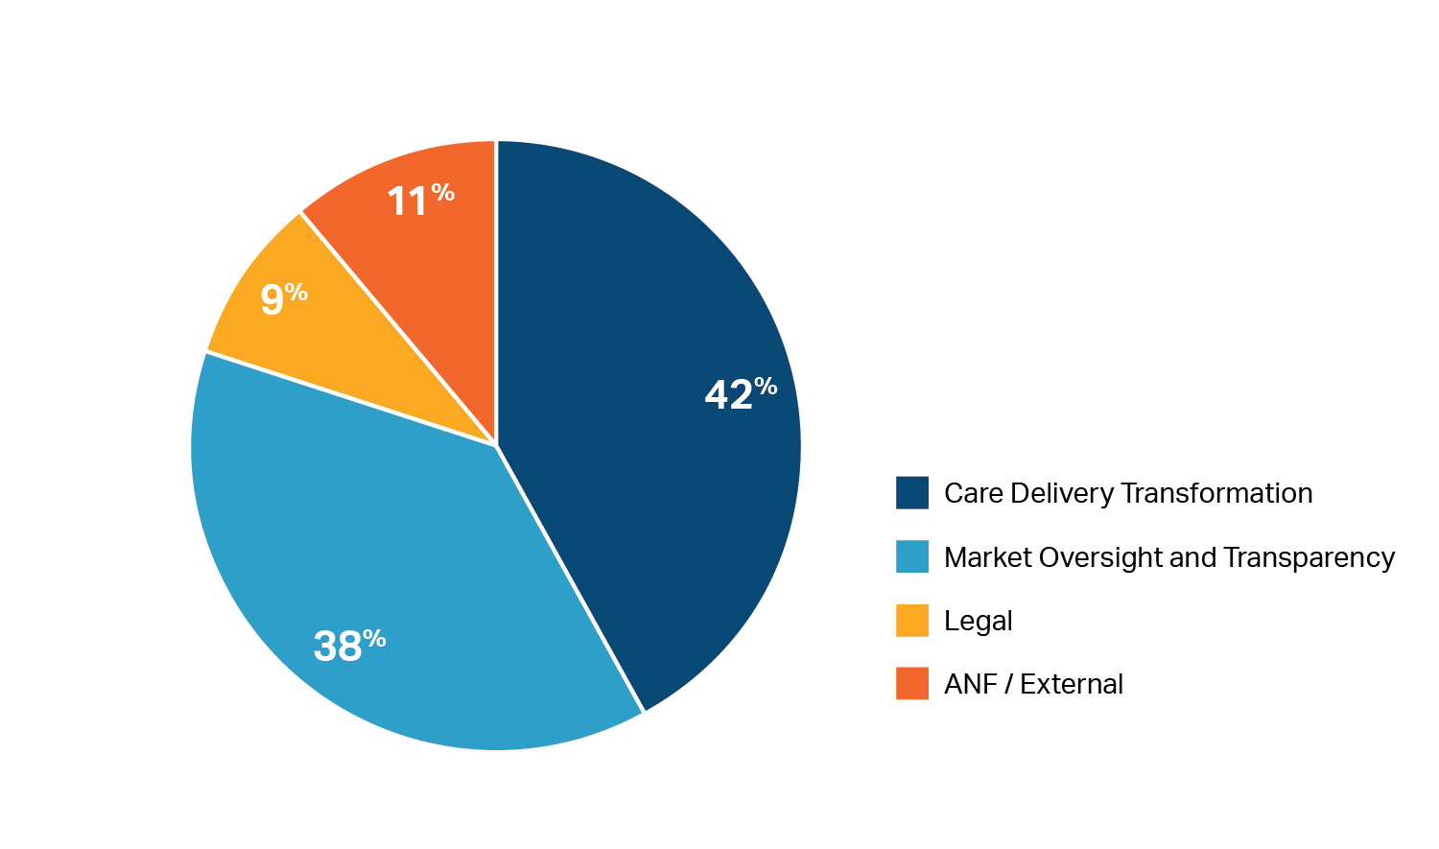
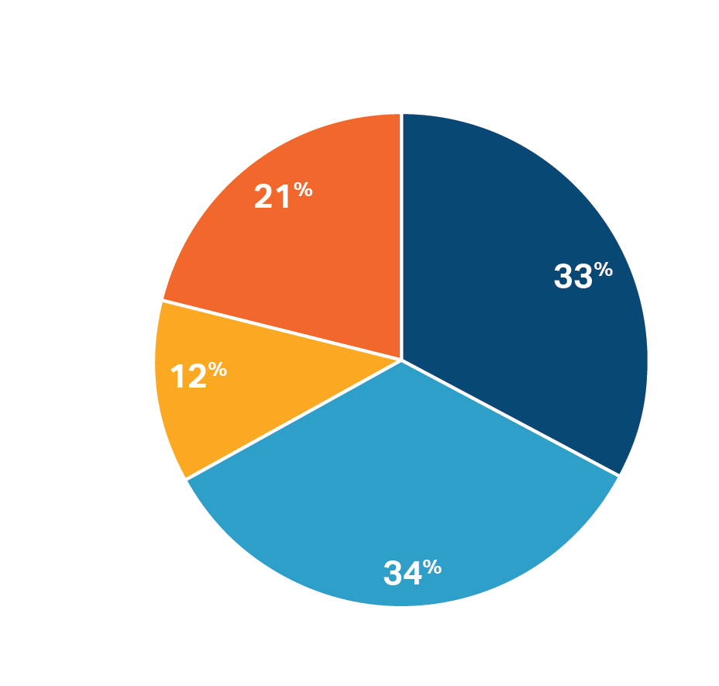
The FY19 budget proposal balances the primary policy priorities of the HPC
Total Payroll and Professional Services
by Major Category
Total FTEs
by Major Category

Slide 29
In 2018, Medicare expenditures grew fastest among the largest components of THCE, while growth in Medicaid expenditures were flat.

Slide 30
The HPC employs four core strategies to realize its vision of better care, better health, and lower costs for all people of the Commonwealth.
RESEARCH AND REPORT
INVESTIGATE, ANALYZE, AND REPORT TRENDS AND INSIGHTS
CONVENE
BRING TOGETHER STAKEHOLDER COMMUNITY TO INFLUENCE THEIR ACTIONS ON A TOPIC OR PROBLEM
WATCHDOG
MONITOR AND INTERVENE WHEN NECESSARY TO ASSURE MARKET PERFORMANCE
PARTNER
ENGAGE WITH INDIVIDUALS, GROUPS, AND ORGANIZATIONS TO ACHIEVE MUTUAL GOALS

Slide 31
The HPC is supporting a new the Massachusetts Employer Health Coalition, which is focusing on reducing avoidable ED use.
Founded in 2018, the Coalition is an employer-led effort that seeks to use our collective influence to uncover solutions that drive real change in the health care delivery system and reduce costs.
Coalition Members are over 25 business organizations or associations that represent a wide array of employers from regions across the Commonwealth. Members share a desire to bring the purchaser voice to the forefront of the health care dialogue and will not consist solely of entities whose primary revenue source is health care.
Strategic Partners are 6 non-profits or government agencies that are essential, significant stakeholders within the health care system. Strategic Partners recognize and are supportive of the role of employers in driving change within the health care system. They use their unique perspective to help identify strategies and best practices for employers to pursue, and commit to supplying data, expertise, and influence to inform Coalition activities and achieve goals.
Achieve a 20% reduction in potentially avoidable ED use to generate as much as $100 million in health care savings over the next 2 years
Achieve a 20% reduction in potentially avoidable ED use to generate as much as $100 million in health care savings over the next 2 years

Slide 32
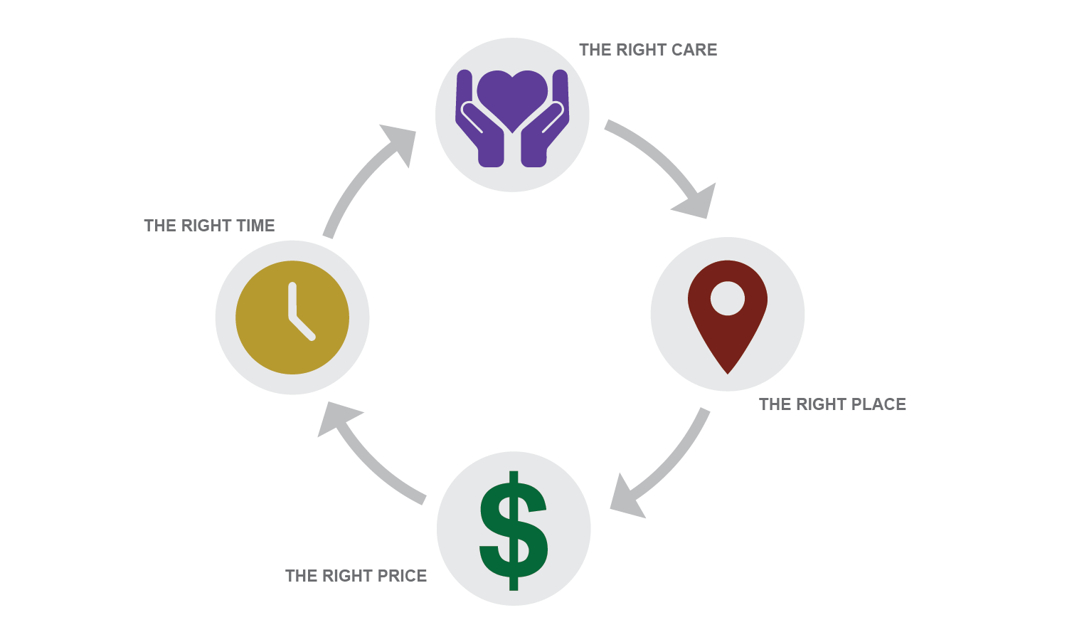
The Coalition’s Vision for Achieving Avoidable ED Savings:
Right Care 4 You

Slide 33
The HPC employs four core strategies to realize its vision of better care, better health, and lower costs for all people of the Commonwealth.
RESEARCH AND REPORT
INVESTIGATE, ANALYZE, AND REPORT TRENDS AND INSIGHTS
CONVENE
BRING TOGETHER STAKEHOLDER COMMUNITY TO INFLUENCE THEIR ACTIONS ON A TOPIC OR PROBLEM
WATCHDOG
MONITOR AND INTERVENE WHEN NECESSARY TO ASSURE MARKET PERFORMANCE
PARTNER
ENGAGE WITH INDIVIDUALS, GROUPS, AND ORGANIZATIONS TO ACHIEVE MUTUAL GOALS

Slide 34
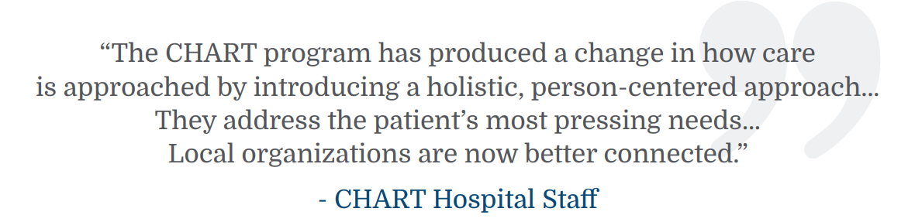
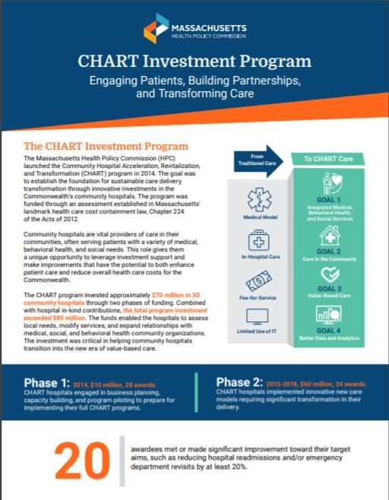
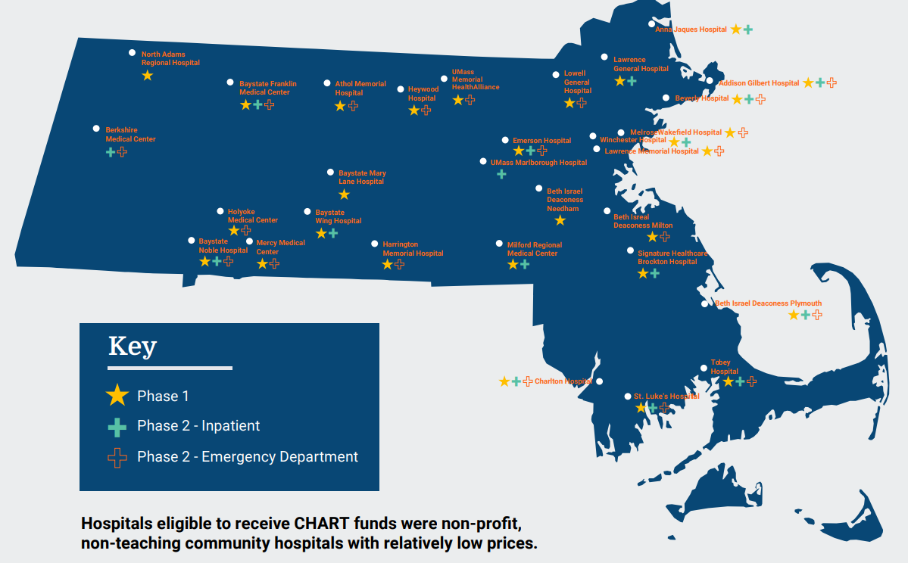
Through the HPC’s CHART investment program, community hospitals made significant progress in reducing utilization and transforming care.
Through the CHART Program, the HPC invested $70 million across 30 community hospitals between 2014 and 2018. The CHART Program Impact Brief provides an overview of the program and highlights community hospital achievements in reducing acute care utilization and establishing a foundation for sustainable care delivery transformation.

Slide 35


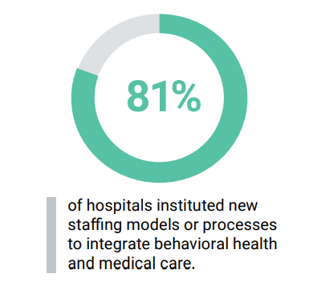



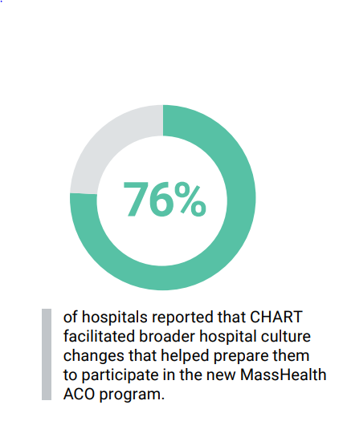

CHART Program: Goals and Achievements
²This estimate covers all ED patients, not only those who were served by the CHART program. CHART funding is likely one of many factors contributing to a decline in ED visits at community hospitals.

Slide 36
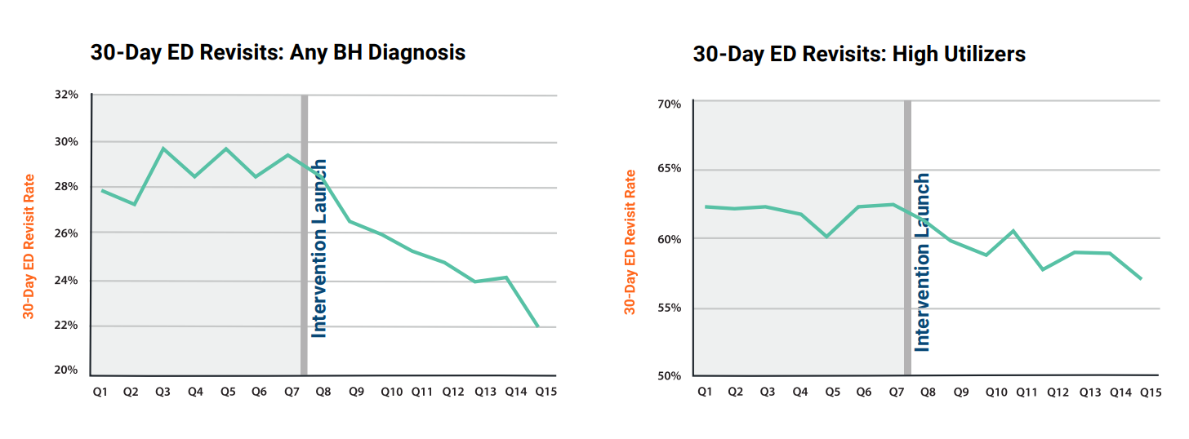

CHART Program: Impact on Reducing Acute Care Utilization

