Slide 1


Rhode Island Health Care Cost Trends
Steering Committee
12th Meeting
February 24, 2020

Slide 2
Agenda
National Academy for State Health Policy Presentation on Pharmaceutical Cost Strategies
Cost Trends Project Sustainability Plan
Brief Updates
Public Comment
Next Steps and Wrap-Up

Slide 3
Pharmacy Spending in Rhode Island, 2016-18*
Key Takeaways:
Medical pharmacy grew much faster than retail pharmacy over the three years.
Total pharmacy spend is approaching 30% of total commercial spend and 25% of total Medicaid MCO spend.
*Per Member Per Month total cost (allowed) dollars (Payer and Member)
Notes:
Commercial self-insured patients who were identified as carved out (most of these were BCBSRI patients) have been excluded.
2018 Medicare non-medical pharmacy data were excluded because the Part D data for 2018 are greatly lagged compared to the medical claims, and Brown doesn't have it yet.
Medicare patients with no claims were excluded from the analysis. Most of these probably have pharmacy coverage through non-Part D sources, or elected not to purchase Part D.
The numbers are very small in Medicaid FFS, and so are probably ignorable
The increase in the PMPM for Duals from 2016 to 2017 is very strange, but that is what the data show.

Slide 4
NASHP Presentation on Pharmaceutical Cost Strategies

Slide 5

Rhode Island Health Care Cost
Trends Project
Steering Committee Meeting
February 24, 2020
Trish Riley
Executive Director
National Academy
for State Health Policy
Notes:
Acknowledge and thank

Slide 6
Source: National health expenditure data found at https://www.cms.gov/Research-Statistics-Data-and-Systems/Statistics-Trends-and-Reports/NationalHealthExpendData/NationalHealthAccountsHistorical. Table 4, National Health Expenditure by Source of Funds and Type of Expenditure. Centers for Medicare & Medicaid Services, Office of the Actuary, National Health Statistics Group.

Slide 7
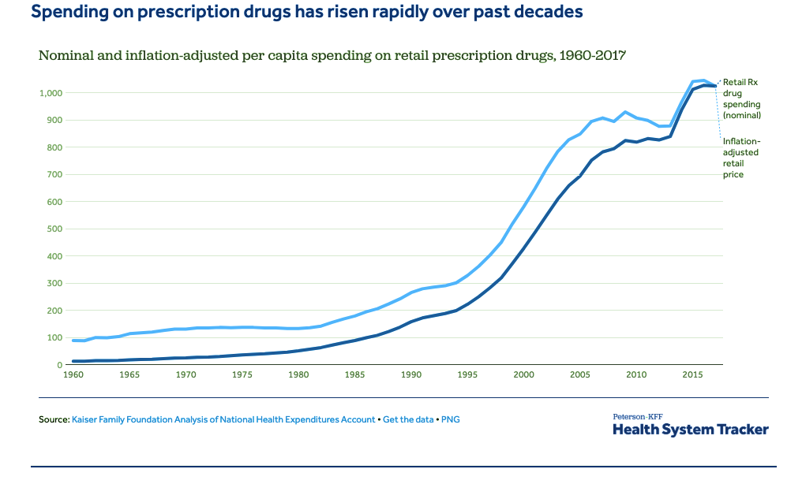

Slide 8
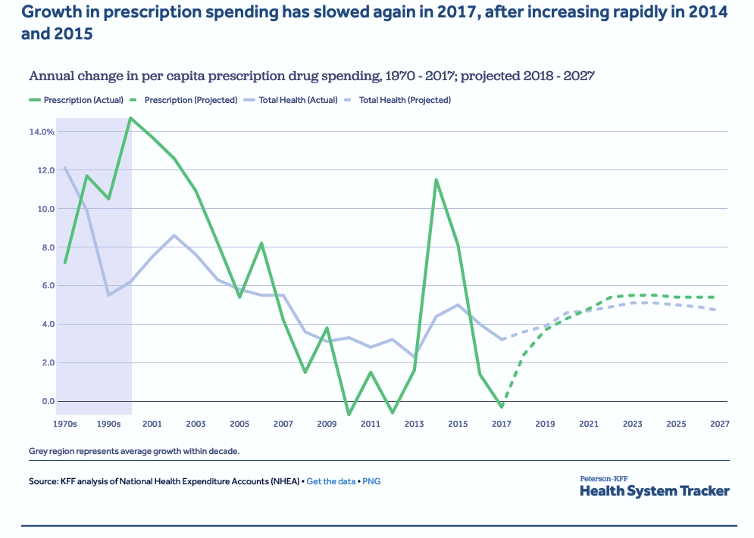

Slide 9
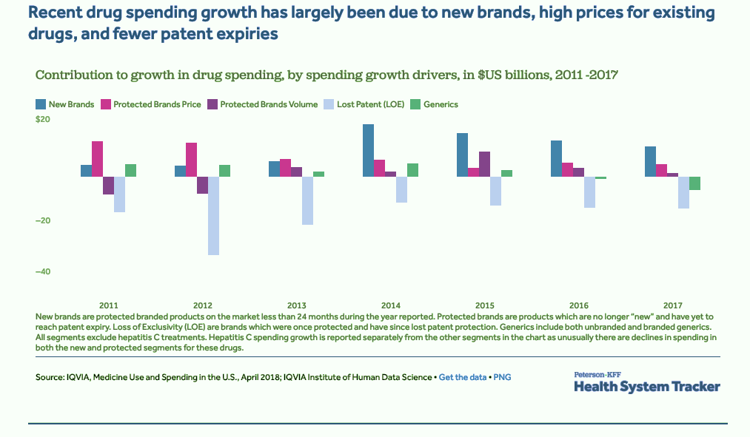

Slide 10
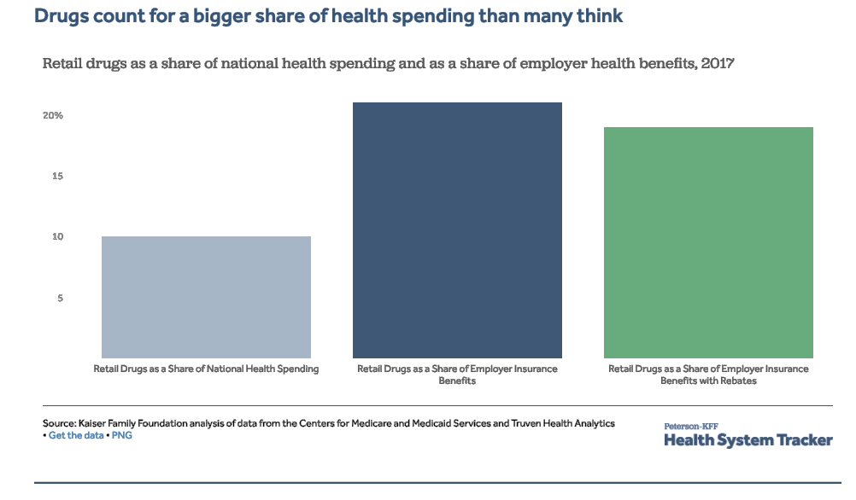

Slide 11
Retail vs. Physician
Administered Drugs
Average Total Rx Spending / Hospital Admission
  18.5% 2015-2017
(NORC, 1/2019)
Need More Data

Slide 12
Why are states taking action on Rx prices?
States can’t wait for federal action:
States are large payers and must fund health benefits for state employees, university, school and municipal employees, corrections staff and Medicaid enrollees.
States must balance their budgets, and rapid and unpredictable Rx price increases make this difficult.
Drug pipeline ensures affordability will continue to be a challenge

Slide 13
Why are states taking action on Rx prices?
Rising drug costs financially strain states and consumers.
Between 2009 and 2017, the wholesale price of a single vial of the insulin Humalog nearly tripled, from $92.70 to $274.70.
The average cost of insulin per person increased from $2,864 in 2012 to $5,705 in 2016.
Specialty drugs entering the market have unsustainably high launch prices.
  Zolgensma launched at $2.1 million for a one-time treatment.
  Luxturna costs $850,000 for a one-time treatment.
Notes:
Zolgensma – gene therapy drug that treats spinal muscular atrophy
Luxturna – gene therapy drug that can cure rare blindness

Slide 14
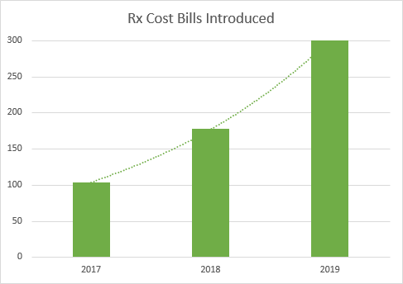
State momentum has grown since 2017.
Every state has introduced legislation to address rising prescription drug prices.

Slide 15
State momentum continues in 2020.
Introduced Bills: 2020 (As of February 11)
Total bills introduced | 331
States with Rx cost bills | 40
Pharmacy Benefit Manager | 128
Transparency | 49
Wholesale from Canada Importation | 33
Affordability Review | 19
Volume Purchasing | 6
Anti-Price Gouging | 3
Coupons and Cost-Sharing | 57
Study | 10
Other | 26

Slide 16
States enact more drug cost laws each year.
Enacted State Rx Pricing Bills: 2017-2019 (As of Jan. 1, 2020)
Year | 2017 | 2018 | 2019
States enacting laws | 13 | 28 | 37
Total laws enacted per year | 18 | 45 | 62
Pharmacy Benefit Manager | 8 | 32 | 33
Transparency | 3 | 4 | 7
Wholesale from Canada Importation | 0 | 1 | 3
Affordability Review* | 1 | 0 | 3
Volume Purchasing | 0 | 0 | 2
Coupons | 1 | 0 | 3
Study | 0 | 1 | 5
Other | 5 | 7 | 6
*Includes New York’s Medicaid drug cap and Massachusetts’ enhanced negotiating authority.

Slide 17
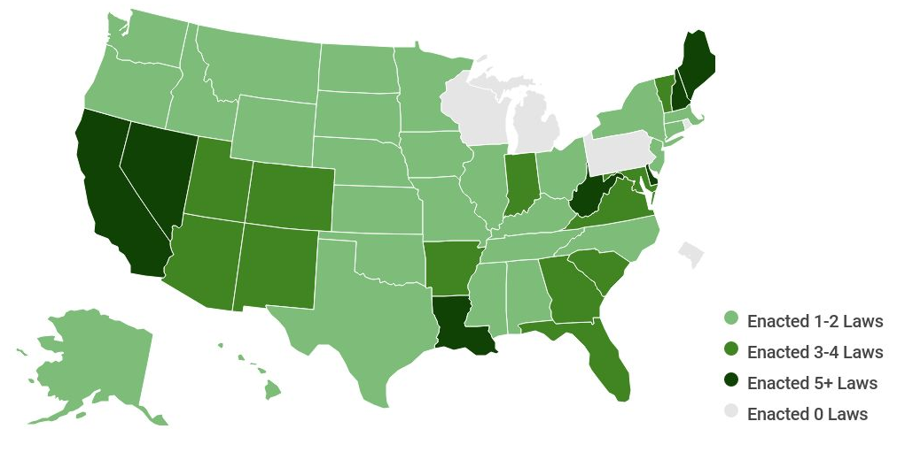
Enacted State Drug Pricing Laws 2017-2019

Slide 18
Prescription Drug Pricing Transparency
Goal: Actionable transparent price data from across the supply chain
NASHP’s model offers a comprehensive approach to transparency reporting
Requires reporting from across the supply chain
  Manufacturers, pharmacy benefit managers, wholesalers, and health plans
Includes a common data set to align reporting across states and to minimize reporting burden
  Adopted by Maine and Connecticut
Includes stronger penalties for failure to report, including giving subpoena power to state agencies to collect information from entities in the supply chain
Notes:
Thresholds for reporting have been tested by data experts and are expected to yield reporting on approx. 30 brand name and 30 generic drugs. They include:
Brand-name: 20% increase per wholesale acquisition cost (WAC) unit over 12 months
Generics: a WAC unit price of $10 or more with a 20% WAC unit increase over 12 months
New drugs: a WAC of $670 or greater
Insurers: top 25 drugs from the past year, representing greatest total spending and the highest year-over-year increase
PBMs and wholesalers: Rebates on top 25 drugs reported by insurers

Slide 19
Transparency laws highlight drugs that create affordability challenges.
Eight states have passed transparency laws: CA, CT, ME, NV, OR, TX, VT, WA.
Transparency data from states already reporting has identified high-cost drugs whose costs are rising fastest and/or are most frequently prescribed.
CA, ME, NV, OR, and VT have already started collecting data and have developed public lists of drugs that account for high total cost or high-cost growth.
  Seventeen drugs were reported in common across at least three states.
  The most commonly reported high-cost drugs across states were diabetes medications.

Slide 20
Highest Total Cost or Highest Cost-Growth Drugs Reported by at Least Three States
Diabetes | Humalog Januvia Lantus Solar Novolog Metformin HCL Metformin HCL ER Victoza
Psoriasis, Psoriatic Arthritis, Rheumatoid Arthritis | Stelara Cosentyx Enbrel Humira Syringe Humira Pen
Asthma | Symbicort
Hepatitis C | Harvoni Epclusa
Multiple Sclerosis | Copaxone Tecfidera
Cardiovascular Issues | Xarelto
HIV | Descovy
At least three of five states (CA, ME, NV, OR, VT) had 17 drugs in common on lists of highest cost and highest cost-growth drugs reported by states.

Slide 21
Pharmacy Benefit Managers (PBMs)
PBMs contract with health plans to administer pharmacy benefits.
NASHP developed two model PBM bills that allow states to define standards for PBM business practices.
  Model Legislation A enables states to directly regulate PBMs.
  Model Legislation B requires health carriers to monitor activities performed by a contracted PBM.
Both models require PBMs to:
  Obtain a state license;
  Have a fiduciary to their health plan clients; and
  Limit patient cost sharing at the point of sale.

Slide 22
Pharmacy Benefit Managers (PBMs)
As major purchasers of drugs for their employee health plans, states can control prescription drug costs by negotiating favorable contract terms with PBMs.
NASHP developed model PBM contract terms that enable states to:
  Restrict PBM compensation to an administrative-fee-only model;
  Eliminate spread pricing;
  Require 100% pass-through of rebate; and
  Provide robust transparency for greater monitoring and enforcement.
Entering into a favorable contract with a PBM through the procurement process may supplement or provide an alternative to direct regulation.

Slide 23
Requirements on PBMs vary by state.
Twenty-eight states require PBMs to obtain licenses that:
  Show how many and what entities operate as PBMs in a state; and
  Give states the power to suspend/revoke licenses if PBMs engage in fraudulent activity.
Nine states require PBMs to report financial information as part of targeted PBM transparency or as part of broader drug cost transparency efforts (CT, NV, WA, TX, ME, LA, AR, IA, MN).

Slide 24
States require varied information from PBMs.
Eight of the nine states with PBM transparency laws require PBMs to report total rebates.
Six of those states require PBMs to disclose whether rebates were passed through to the insurer.
States also require reporting about:
  The amount of money retained by PBMs;
  Administrative fees paid to PBMs;
  Amount paid for pharmacy services; and
  Whether rebates were passed through to insurers and consumers.
Notes:
]

Slide 25
States require varied information from PBMs.

Slide 26
Background: Wholesale Canadian Drug Importation
Federal certification:
Federal Food, Drug, and Cosmetic Act (FDCA), Section 804, allows the Department of Health and Human Services Secretary to approve a program of wholesale importation of prescription drugs that will:
  Poses no additional risk to the public’s health and safety; and
  Results in a significant cost reduction in the covered products to the American consumer.
Federal requirements:
Prescription drugs may only be imported from Canada.
NO importation of a controlled substance, biological product, infused drug, intravenously injected drug, or a drug inhaled during surgery is permitted.
All safety provisions in the FDCA must be followed (e.g., track and trace) as well as additional laboratory testing requirements.

Slide 27
Wholesale Importation Supply Chain Safety
The drug supply chain is already a global one.
  63% of drugs sold in the US are manufactured in other countries.
  88% of raw materials in US drugs come from abroad.
Safety standards are comparable.
  Federal regulations already ensure the safety of foreign-produced drugs entering the US market.
  More than 30 Canadian drug manufacturers are FDA-registered to produce drugs for the US market.

Slide 28
Example of importation program cost savings
Lower Canadian drug prices have the potential to save states and consumers money.
Importing Zytiga, a prostate cancer drug, is 64% cheaper, even after mark-up along the supply chain.
Zytgia in the supply chain:
Repack/relabel: ~15% [$3.23]
+
Testing: ~5% [$1.08]
+
Records/recall management: ~5% [$1.08]
+
Profit to supply chain: ~20% [$4.31]
=
Overall supply chain markup: $9.70
Zytiga
US price: $87.63
Canadian price: $21.56
Difference: $65.97
Resulting cost to state: $31.26
Savings after supply chain costs: ~64%
Notes:
This is the price per tablet

Slide 29
Drug Affordability Review Board
NASHP’s model creates a drug affordability review board that can establish upper payment limits for high-cost drugs that cross certain thresholds.
A state determines triggers to review drugs.
Drug companies have the opportunity to justify prices.
The board reviews information and establishes an upper payment limit that applies throughout the health care system.
Maine and Maryland are implementing modified drug affordability boards:
Maine allows its board to determine drug spending targets for public entities.
Maryland’s board may begin to set upper payment limits for drugs purchased by public entities in 2022, pending approval by the General Assembly. In 2023, the board will recommend whether the assembly should pass legislation to expand upper payment limits to all purchasers.

Slide 30
States seek more control over Medicaid pharmacy benefits.
West Virginia carved pharmacy benefits out of its Medicaid managed care program in 2017.
  The state saved over $54 million from its shift to fee for service.
  Michigan is considering implementing a similar policy.
Ohio now requires all managed care plans to contract with a single PBM that will be selected by its Medicaid department.
  It previously required managed care plans to use a transparent, pass-through payment model that prohibited spread pricing.
Washington State’s Medicaid program implemented a single formulary for all managed care and fee-for-service pharmacy benefits.

Slide 31
States explore alternative Medicaid payment models.
Louisiana and Washington are implementing a “Netflix” subscription-based payment model to treat hepatitis C.
  States solicit bids for a contract with a drug manufacturer, and
  Pay a “subscription” fee to a winning drug company for unlimited access to a drug for a fixed, predetermined cost.
CO, MA, MI and OK have received approval for State Plan Amendments that allow for outcomes-based contracts with drug manufacturers.
  Enables states to negotiate contracts based on agreed-upon outcome measures tailored for specific drugs.

Slide 32
Spending caps and enhanced negotiating authority
New York Medicaid has authority to negotiate with drug companies for supplemental rebates if drug spending is projected to exceed the annual spending limit.
  If unable to reach an agreement, drugs are referred to its Drug Utilization Review Board for a “value assessment.”
Massachusetts’ Health and Human Services has authority to negotiate supplemental rebate agreements with manufacturers.
  If unable to reach an agreement and the drug meets price thresholds, the drug is referred to the Health Policy Commission for further review.

Slide 33
New Models Coming Soon!
Buy-In to State Employee Health Plan (Available)
    Public Purchasing Policy
Price Gouging
Modified DARB
Formulary Access
And More…

Slide 34
NASHP’s Prescription Drug Pricing Center is supported by Arnold Ventures.
Legislative Tracker
Administrative Actions
Legal Resources
Model Legislation
Newly-Enacted Laws
Updated 2/18/2020

Slide 35
Cost Growth Target Sustainability Plan

Slide 36
Sustainability Plan
This past summer the Peterson Center on Healthcare committed to 18 months of continuing support to the Cost Trends Project (→ 2/2021).
We have anticipated the need to secure funding for ongoing support through the Governor’s budget and the legislature, and perhaps through private funders.
During the December 2, 2019 Steering Committee meeting, we solicited your input on a straw model on sustainability. Several concerns were raised.
On 2/10 Marie distributed a memo outlining why the co-chairs altered the sustainability structure proposed in December and shared a new proposed approach and the Governor’s budget article. A further refined draft sustainability plan was distributed to you on 2/20.

Slide 37
Sustainability Plan
Today, we would like to:
  discuss the new proposed approach,
  solicit feedback, and
  discuss next steps to ensure sustainability of the Cost Trends work.

Slide 38
Sustainability Plan: Changes Since December
December Sustainability Plan | February Sustainability Plan
Structure and governance: Create a public/private entity sanctioned by the State with independent authority | Structure and governance: Maintain the Cost Trends Steering Committee in its present form to make recommendations to the State
Mission: Limit health care cost growth and incorporate the work following from the RI Foundation’s Long Term Health Planning Committee | Mission: Remain focused on limiting health care cost growth
Functions: 1) maintain a cost growth target; 2) publicly report on performance against the target; 3) leverage the APCD to report on cost and cost growth drivers & highlight opportunities, and 4) facilitate multi-stakeholder collaboration to address opportunities | Functions: No change
Staffing and budget: Staff through a contractor, with an estimated budget of $700K-$1.3M/year. | Staffing and budget: Staff through OHIC-contracted personnel with an estimated budget of $680K-$1.3M/year.
Financing: Fund through a mix of public and private funds | Financing: Fund through a $1 annual assessment on insured and self-insured commercial lives, plus unspecified additional public and/or private funds

Slide 39
Sustainability Plan: Next Steps
  Finalize plan
  Gain legislative support for Governor’s budget article
  Identify supplemental sources of funding

Slide 40
Brief Updates

Slide 41
Baseline Performance Measurement Against the Cost Growth Target and the Report Design Work Group
Baseline Performance Measurement Against the Cost Growth Target
Project staff are currently validating the 2017 and 2018 baseline data submissions from the four insurers.
Project staff are planning to bring baseline performance results to the April Steering Committee meeting, so long as any insurer requests for clarification or correction are resolved in a timely manner.
Report Design Work Group
The Report Design Work Group has held five meeting thus far.
The Work Group recently looked at some of Brown’s initial analyses. These will later lead to the design of reports for production.

Slide 42
May 29, 2020 Public Meeting
South Street Landing, Providence
Start | Topic
7:30am | Arrival and Light Breakfast
8:00am | Welcome and Opening Remarks – Marie Ganim Overview of the Cost Trends Work Project Activity Since May 2019 Meeting
8:10am | Overview of State Efforts to Implement Cost Growth Targets and Discussion – Chris Koller
9:10am | Moving the Needle on Cost Growth in Massachusetts and Discussion – David Cutler
10:10am | Break
10:15am | 2017-2018 Baseline Performance Against the Cost Growth Target and Discussion – Megan Burns
11:15am | Review of New Analyses of Cost Drivers and Cost Growth Drivers and Discussion – Ira Wilson
12:15pm | Next Steps – Marie Ganim Provider Collaborative Convenings

Slide 43
Public Comment

Slide 44
Next Steps

Slide 45
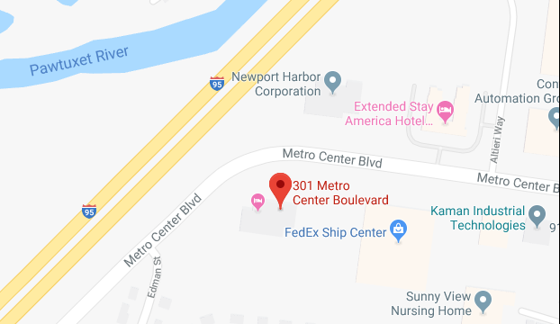
Next Meeting
Where: 301 Metro Center Blvd, Suite 203, Warwick
When: April 20, 1:00pm – 3:00pm
Topics:
Baseline performance against the Cost Growth Target
Brown analysis of cost and cost growth drivers
How the Steering Committee will work collaboratively with the Choosing Wisely Campaign

